Slide 1
Guide for Finding Historically Underutilized Businesses (HUBs)
on the CMBL
(Centralized Master Bidders List)

Slide 2





TABLE OF CONTENTS
Search for HUB Status of Vendor on CMBL
(Pages 3)
Search HUB Vendors by Commodity/ Service Description
(Pages 4 - 11)
Search HUB Vendors by Business Category
(Page 12 - 16)
  Convert Category Search Results to Microsoft Excel
(Page 17 - 22)
NIGP Class and Item Codes for Construction Services
(Page 23)
NIGP Class and Item Codes for General Commodities/ Services
(Page 24)

Slide 3
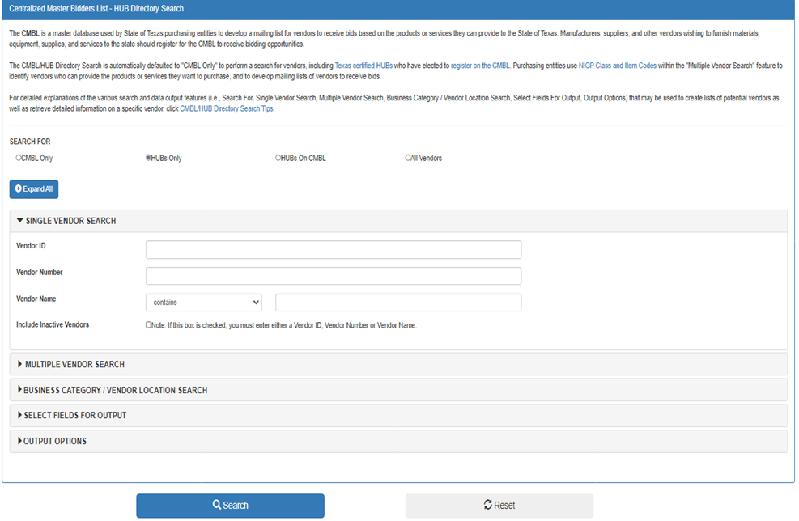
Search to verify vendor HUB status on CMBL
Open website, https://mycpa.cpa.state.tx.us/tpasscmblsearch/tpasscmblsearch.do
Click on the “HUBs Only” radio button
Expand the “Single Vendor Search” icon
Enter vendor name in the “Vendor Name” section then click on Search
  If vendor is not a HUB, you will get a message that no vendors found for the search condition entered (i.e. ”Error: Sorry, No vendors found for the search condition entered.
  Search Condition : Search Type=HUB's Only, Vendor Name contains Roscoe.”)
  If vendor is a HUB, a “Results” page of the search will appear with the HUB info.
Select ‘HUBs Only’

Slide 4
Search the CMBL for
HUBs by Commodity/Service Description
Click on this link to open the CMBL Home Page: https://mycpa.cpa.state.tx.us/tpasscmblsearch/tpasscmblsearch.do
~then~
Go to the next page (pg. 5) of this guide for step-by-step instructions on how to do a search.
Tip: If you have dual monitors, it is helpful to have this guide open on one and your default browser on the other.

Slide 5






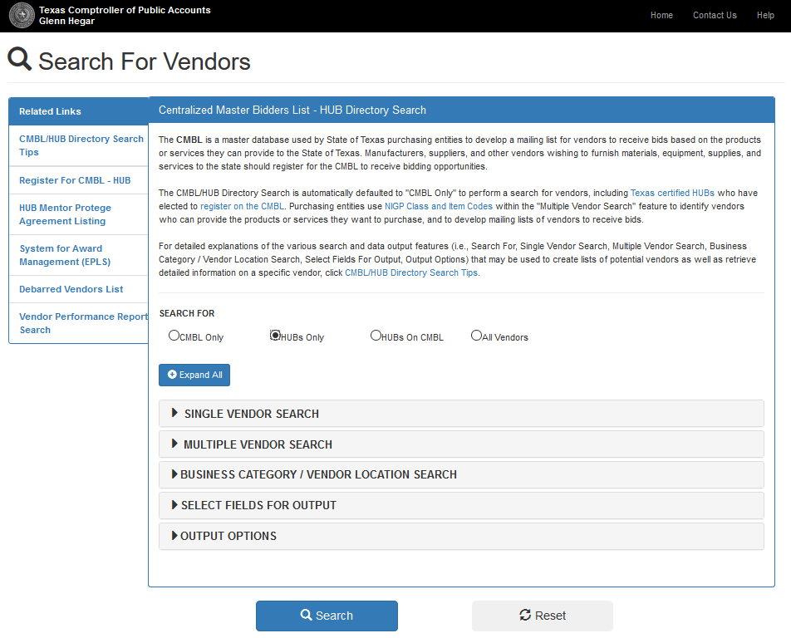
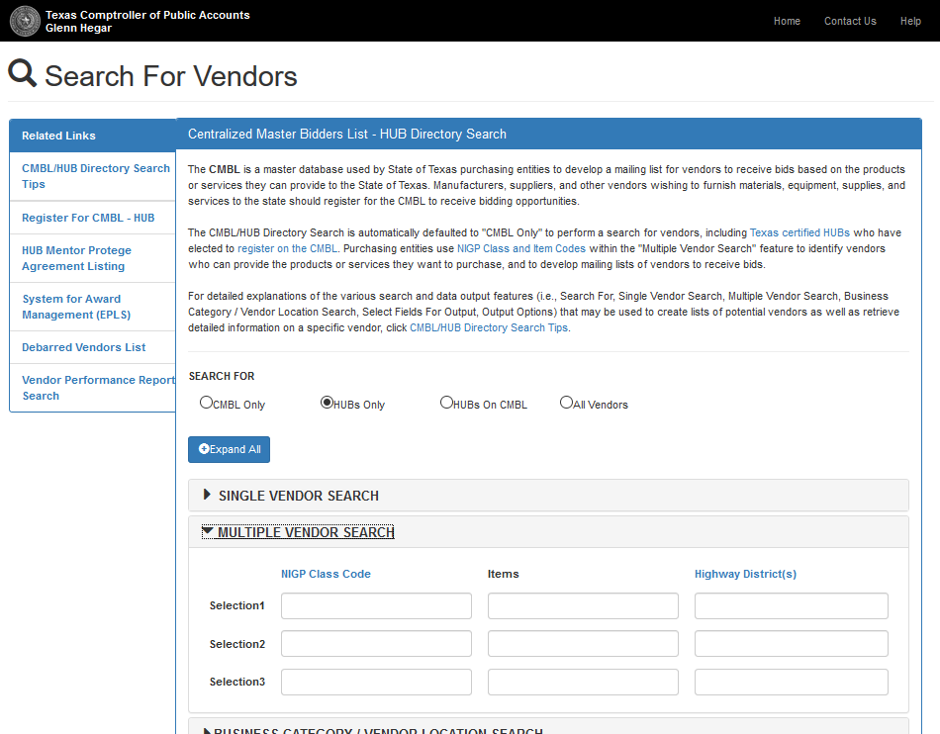

HUB Search by Commodity/ Service Description
Step 1.
Step 2.
(CMBL home page)
Select ‘HUBs Only’
1) Expand the ‘MULTIPLE VENDOR SEARCH’ Option
2) Click on ‘NIGP Class Code’ link. *Note: the page will open in a new tab in your browser
**Note: If you are looking for all subcontractors or vendors,
select ‘All Vendors’
~Go to next page for Step 3~

Slide 6


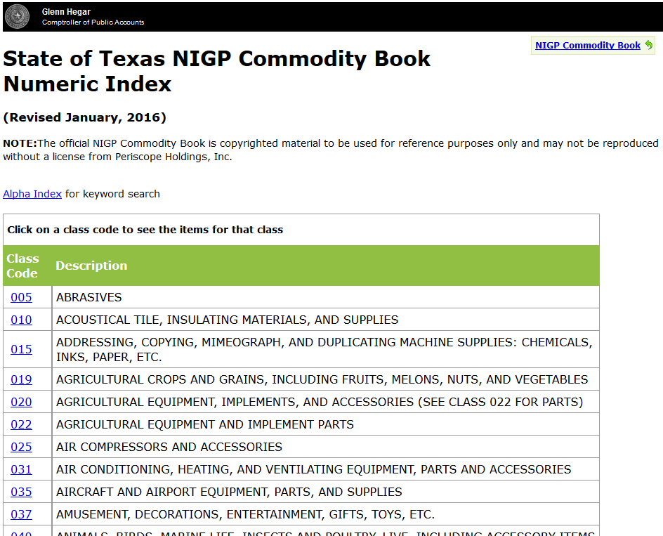
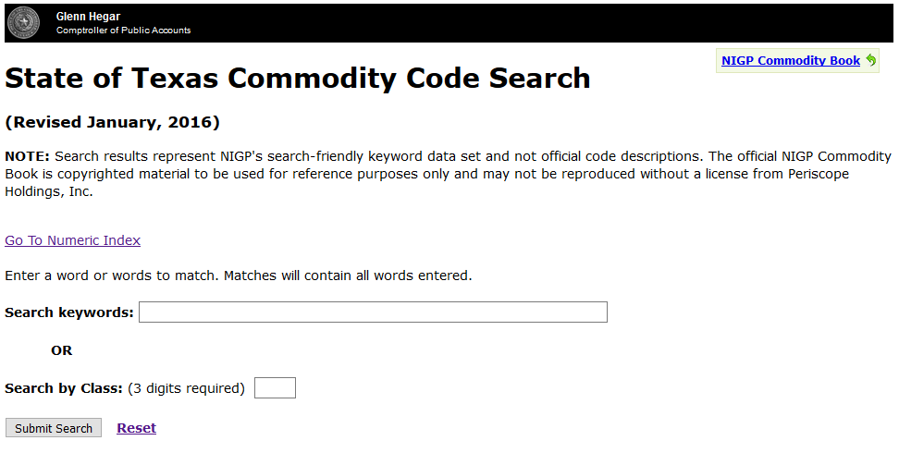

HUB Search by Commodity/ Service Description
Step 3.
Step 4.
Click on Alpha Index link to search by keyword, and you will be taken to this page
~Go to next page for Step 5~

Slide 7


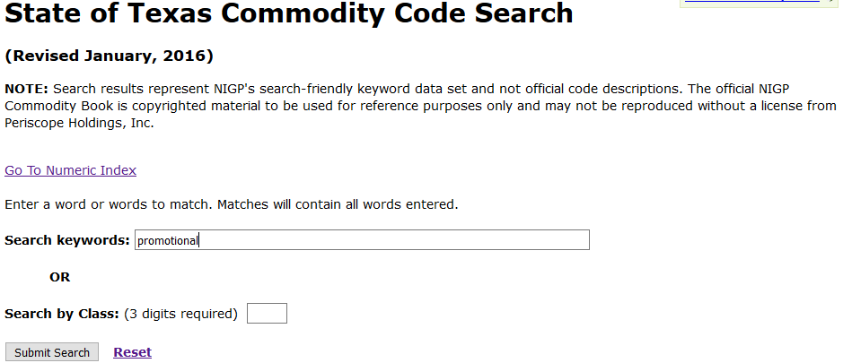
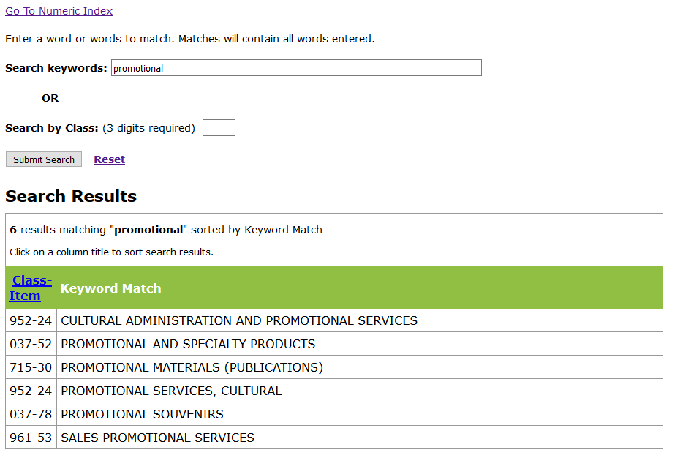


HUB Search by Commodity/ Service Description
Step 5.
Step 6.
1) Find the Class and Item(s)* that best suit what you are looking for. You will have to write these numbers down, or remember them. Then,
1) Type in keywords (hint: use generic terms, if possible) In this example, we will use Keyword “promotional’
2) Click on the Search For Vendors tab at
Step 6a.
the top of your browser and you will be returned to the CMBL home page
2) Click on “Submit Search”
~Go to next page for Step 7~
* Class Code: first three numbers
Item Code: last two numbers

Slide 8


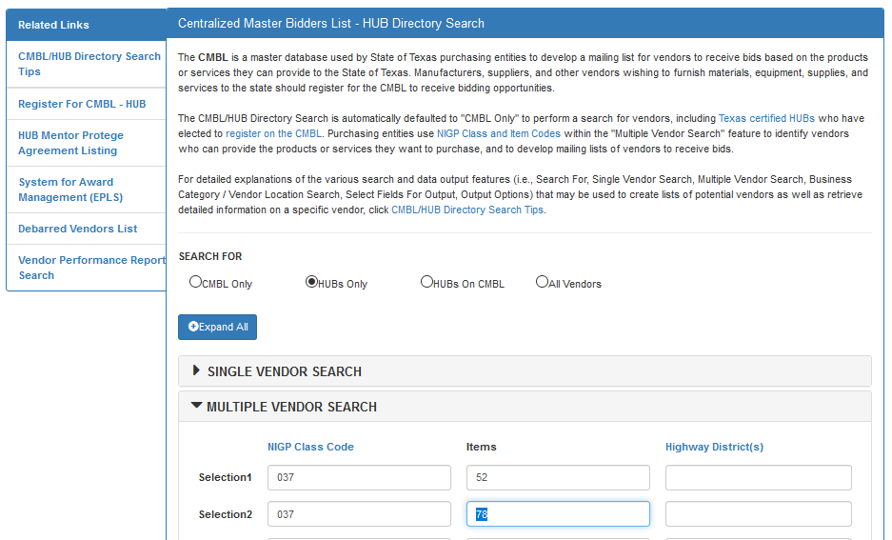
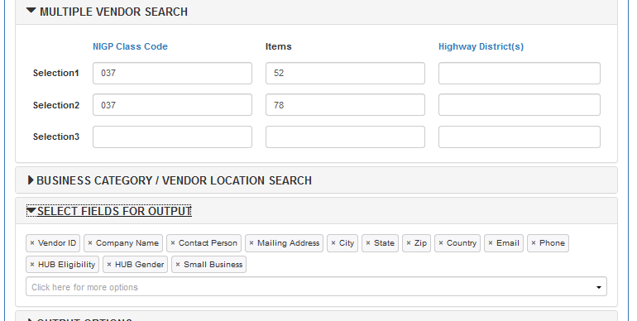

HUB Search by Commodity/ Service Description
Step 7.
Step 8.
TIP: Enter only the Class Code for a more comprehensive list of vendors
After entering the codes, expand “SELECT FIELDS FOR OUTPUT” by
clicking on the black arrowhead.
Enter the Class Code(s) here
Enter the Item Code(s) here
Note: Avoid using “Highway District” as a search criteria. The search result is not a comprehensive list of HUBS doing business in those counties.
~Go to next page for Step 9~

Slide 9


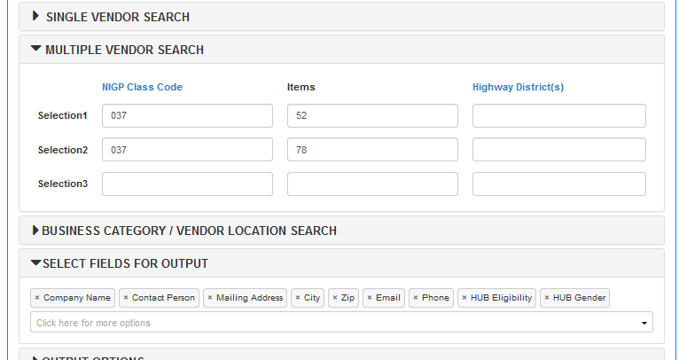
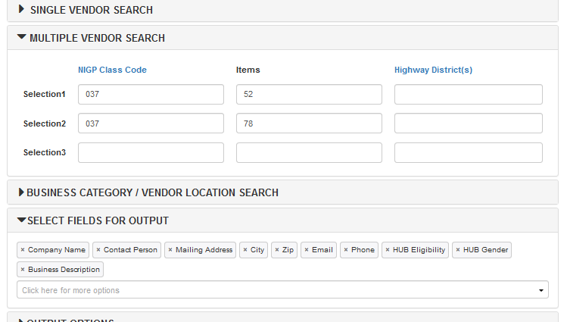

HUB Search by Commodity/ Service Description
Step 9.
Step 10.
Add Business Description and Website by choosing them from the dropdown box below the fields
Add Business Description by choosing it from the dropdown box below the fields
Remove all fields except for the ones showing below by clicking the ‘x’ next to the description
~Go to next page for Step 11~

Slide 10


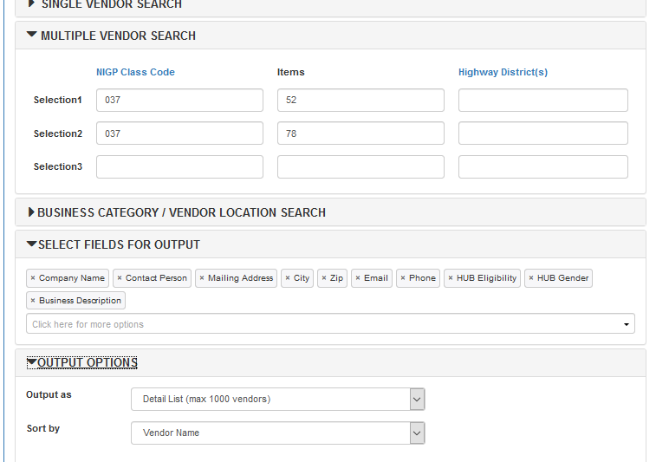
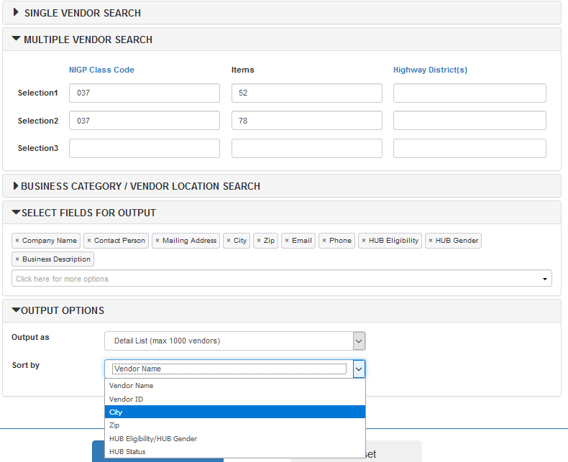

HUB Search by Commodity/ Service Description
Step 11.
Step 12.
Next, expand “OUTPUT OPTIONS” by clicking on the black arrowhead.
1) Use the ‘Sort by’ drop-down to select how you want the information sorted. In this example, we will use “City”
Note: Detail List is the default Output Option. If you prefer download to Excel, you will find that option in the dropdown list.
2) Click the Search button
The next page will show you the results of your search

Slide 11




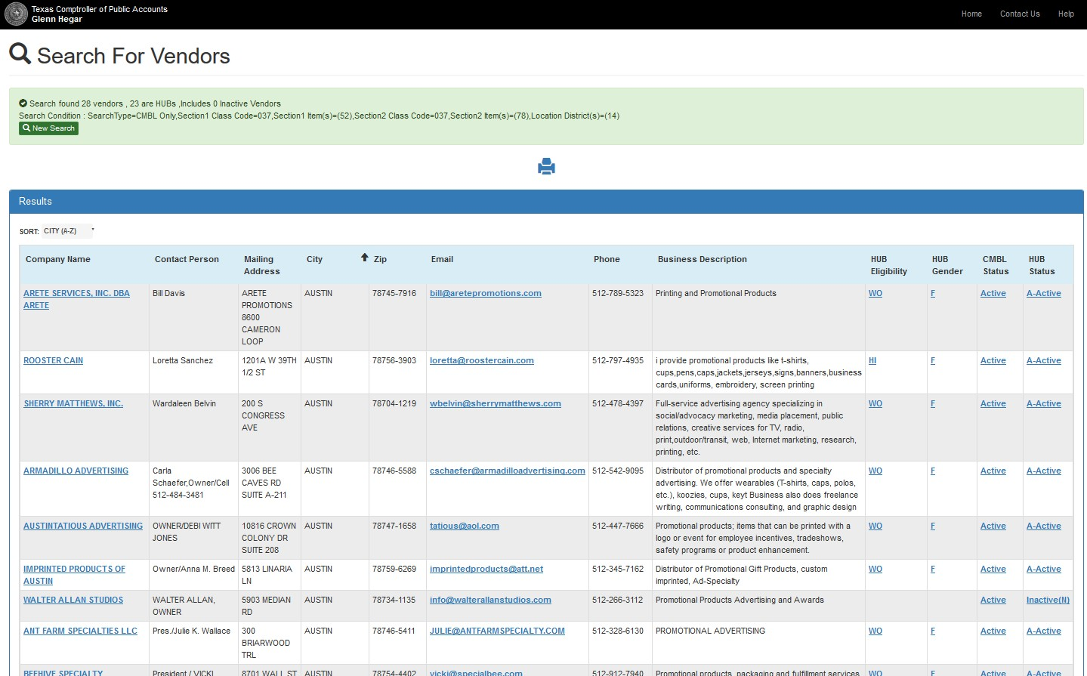
HUB Search by Commodity/ Service Description
Results of Searching HUBs by NIGP Class & Item/ Description.
Read Business Description to see which vendors most closely match what you are looking for.
Click on Company name for more information
Make sure to choose only vendors listed with A-Active status, if searching for a HUB vendor
*
**
Email links are provided so you can solicit bids directly
These codes tell you what “kind” of HUB the Vendor is (see below for code definitions)
*Eligibility/ Ethnic codes: AS - Asian
AI - Native American BL - Black
HI - Hispanic
SDV - Service Disabled Veteran WO - Woman-owned
**Gender codes: F - Female
M - Male

Slide 12
Search the CMBL for
HUBs by Business Category
Click on this link to open the CMBL Home Page: https://mycpa.cpa.state.tx.us/tpasscmblsearch/tpasscmblsearch.do
~then~
Go to the next page (pg. 13) of this guide for step-by-step instructions on how to do a search and transport results to Microsoft Excel .
Tip: If you have dual monitors, it is helpful to have this guide open on one and your default browser on the other.

Slide 13


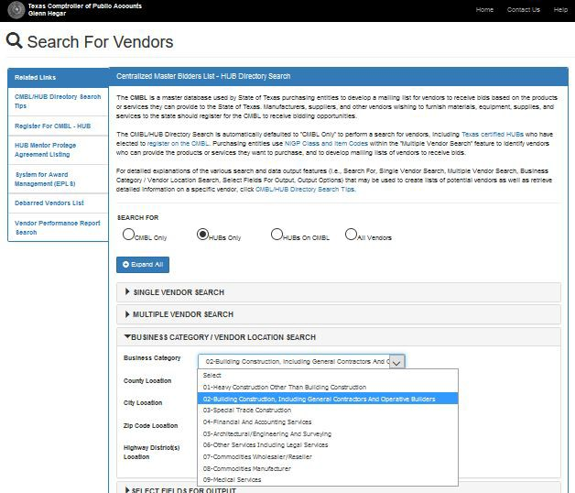



HUB Search by Business Category
Step 1.
(CMBL home page)
Step 2.
1) Expand the ‘BUSINESS CATEGORY’ Option, then
Select ‘HUBs Only’
2) Select from the drop-down the Category you want to search. For this illustration, we will select 02- Building Construction
**Note: If you are looking for all subcontractors or vendors,
To limit your search scope, you can enter County, City, or Zip Code
select ‘All Vendors’
~Go to next page for Step 3~

Slide 14
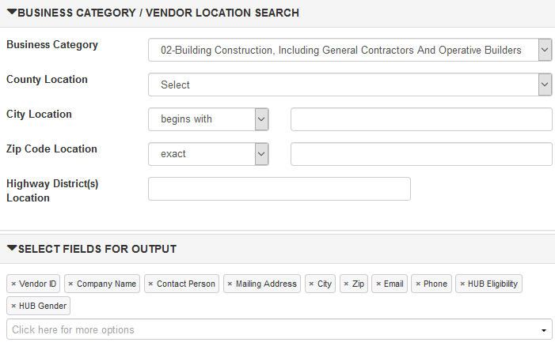
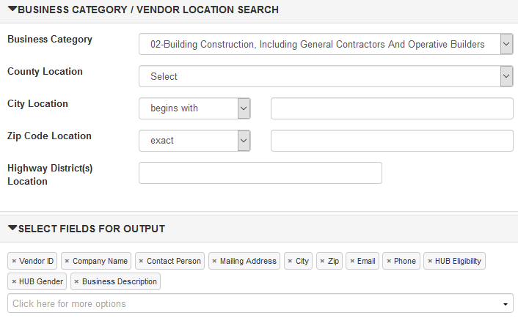
HUB Search by Business Category
Step 3.
Step 4.
After entering the Business Category, expand “SELECT FIELDS FOR OUTPUT”
by clicking on the black arrowhead.
Add Business Description by choosing it from the dropdown box below the fields
Then remove all fields except for the ones showing below by clicking the ‘x’ next to the description
~Go to next page for Step 5~

Slide 15


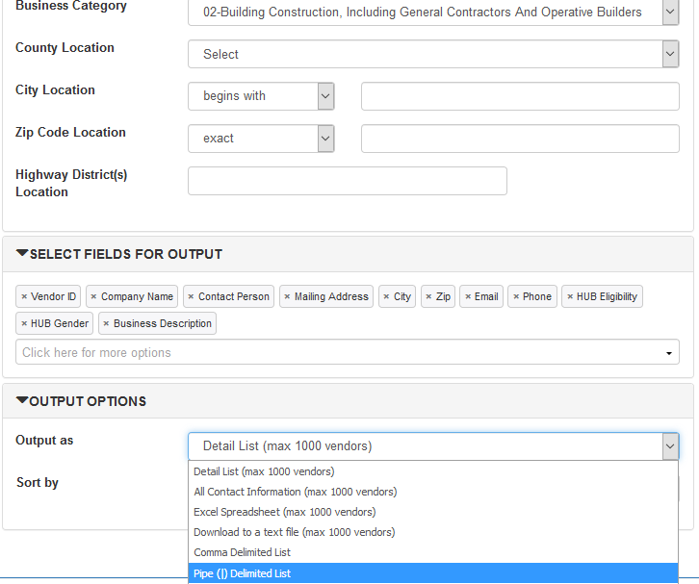
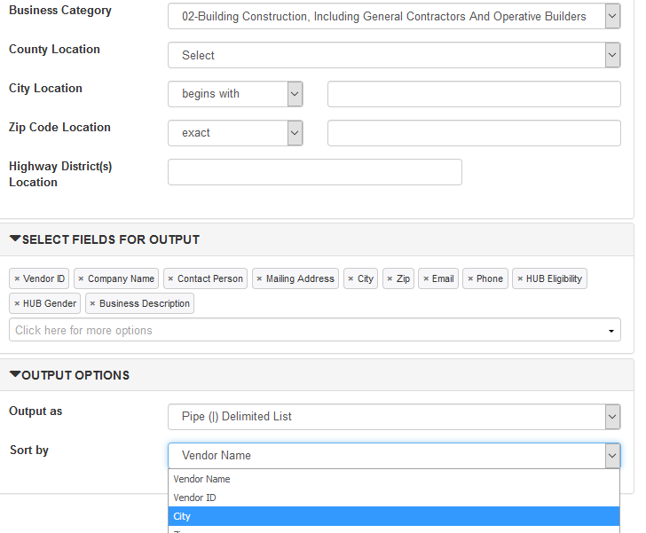
HUB Search by Business Category
Step 5.
Step 6.
Next, expand “OUTPUT OPTIONS” by clicking on the black arrowhead.
Use the ‘Sort by’ drop-down to
select how you want the information sorted. In this example, we will use “City”
After selection, click the Search button
Note: Detail List is the default Output Option. The 02-Building Construction Business Category, however, will exceed the max 1000 vendors limit, so select “Pipe (|) Delimited List” option.
The next page will show you the results of your search

Slide 16



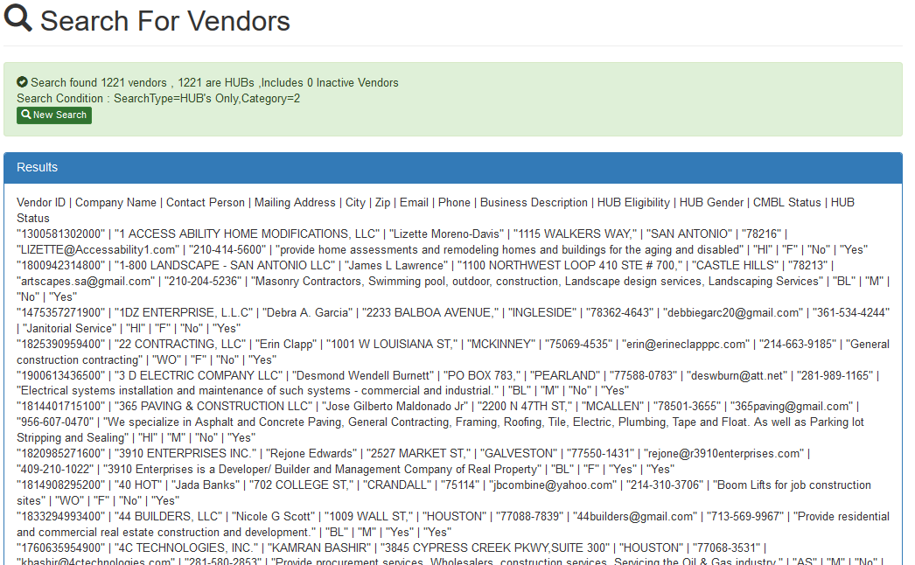
HUB Search by Commodity/ Service Description
Results of Searching HUBs by Business Category using Pipe (|) Delimited List.
~Go to next page for how to transport this information to Microsoft Excel

Slide 17






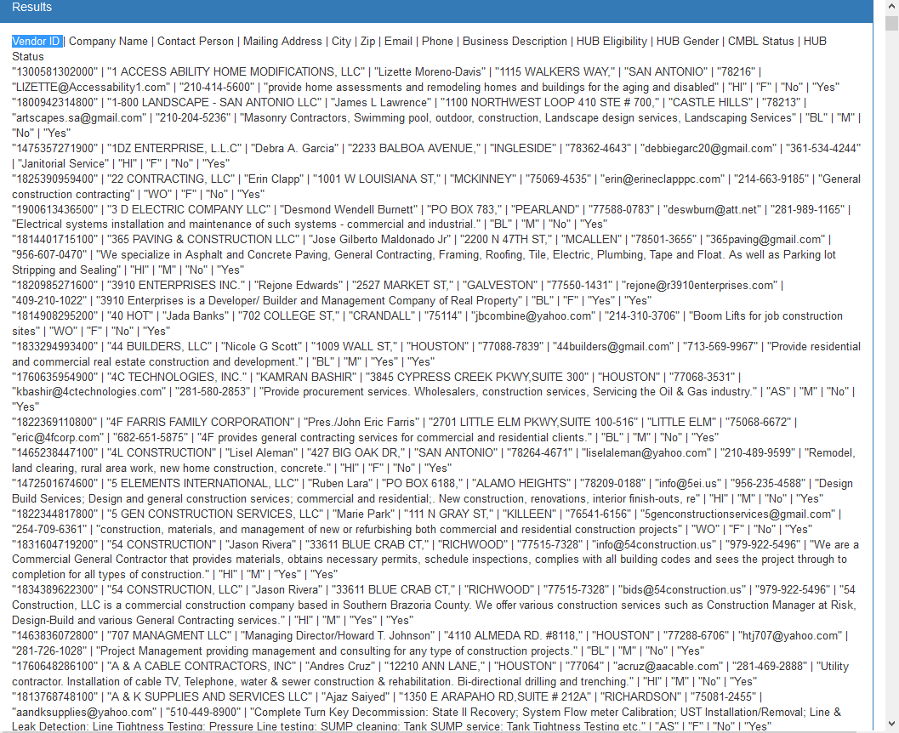
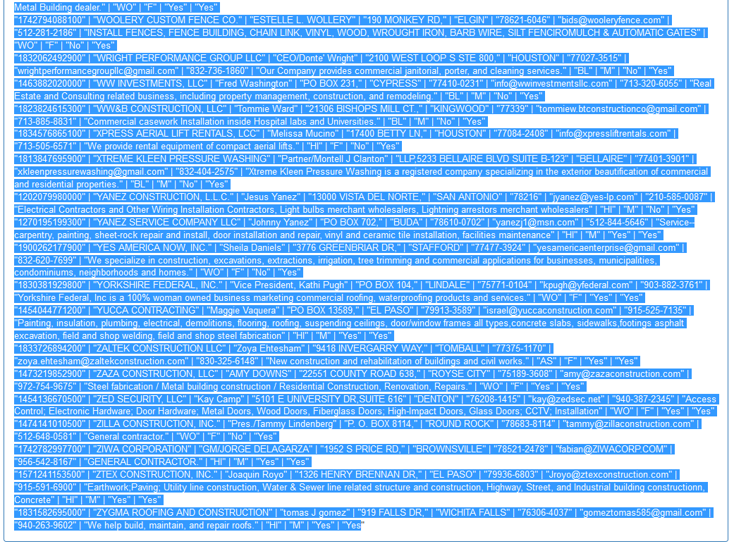


HUB Search by Business Category – Convert to Excel
Step 1. Step 2.
1) At the bottom of the page, while still holding down the Shift key, click on the last word or character of the search results. This will highlight the entire list.
1) Highlight first few words, then hold down the Shift key on your keyboard
2) While holding down the Shift key, click and hold the vertical scroll bar, then pull it down to the bottom of the page
2) Release the Shift key, then hold down the Ctrl key while pressing the “c” key (Ctrl+c). This will copy the highlighted data.
~You are now ready to transport
the data to Microsoft Excel ~

Slide 18
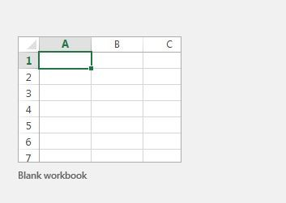
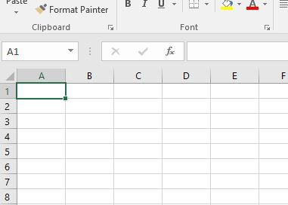
HUB Search by Business Category – Convert to Excel
Step 1. Step 2.
Open Microsoft Excel, click on “File” tab, select “New” and choose the “Blank Workbook” option
When Workbook opens, make sure the A-1 cell is outlined, then hold down the Ctrl key while pressing the “v” key (Ctrl+v). This will paste the data into your Excel sheet.
~Go to next page for Step 3~

Slide 19
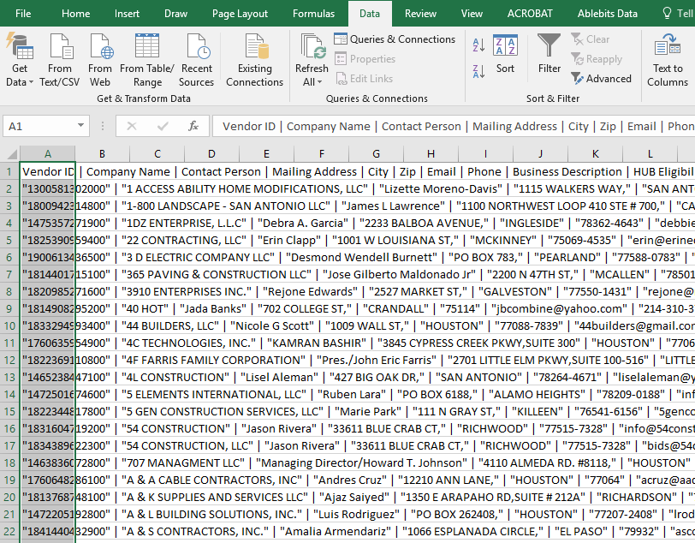
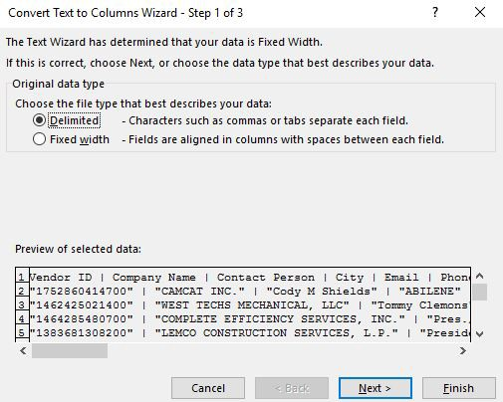
HUB Search by Business Category – Convert to Excel
Step 3. Step 4.
Select “Delimited” ,
then click the Next > button
Column A will be highlighted.
Next, click” on “Data” tab, then “Text to Columns” option.
Add Business Description by
choosing it from the dropdown box below the fields
A “Convert Text to Columns Wizard” will appear.
~Go to next page for Step 5~

Slide 20
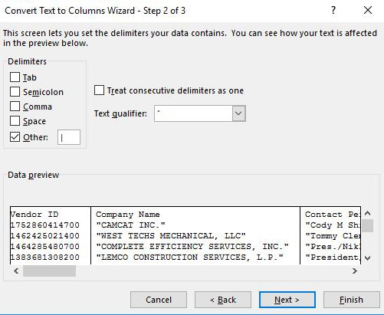
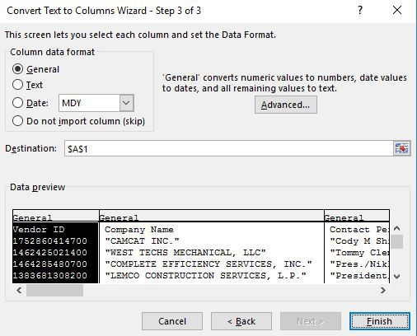
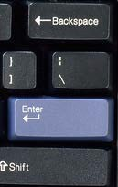

HUB Search by Business Category – Convert to Excel
Step 5. Step 6.
1) Next, uncheck any default checked boxes, then check the Other: box. Enter a “|” (vertical bar) in the space to box to the right (see instructions below)
Use the ‘Sort by’ drop-down to
select how you want the information sorted. In this example, we will use “City”
After selection, click the Search button
2) click the Finish button
2) click the Next > button
~Go to next page for Step 7~
Shift + | =

Slide 21
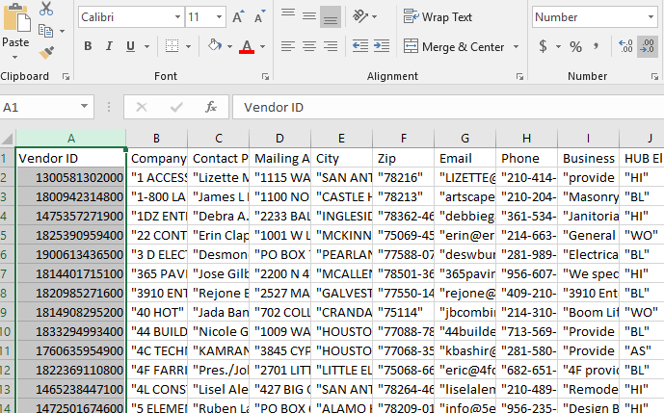
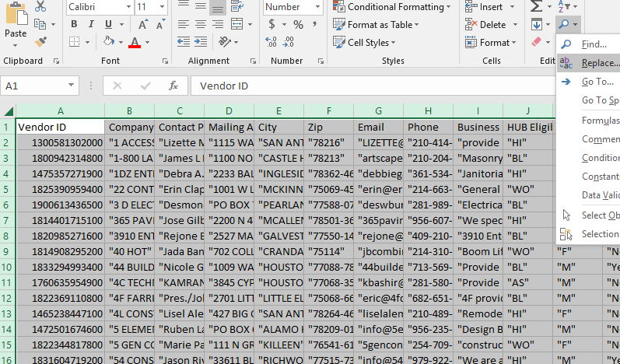
HUB Search by Business Category – Convert to Excel
Step 7. Step 8.
1) Return to “Home” tab (not shown). Change Column A to Number (choose from the drop- down box)
1) Click the arrowhead in the top left corner of the sheet to highlight all cells, then
2) Decrease decimals by two
2) Click “Search” icon, and select “Replace” option.
~Go to next page for Step 9~

Slide 22
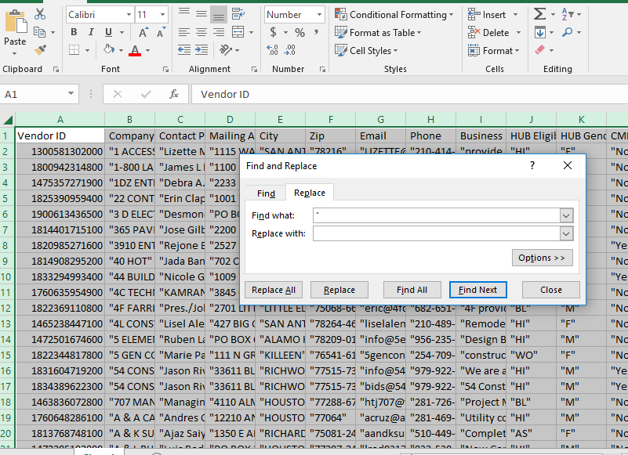
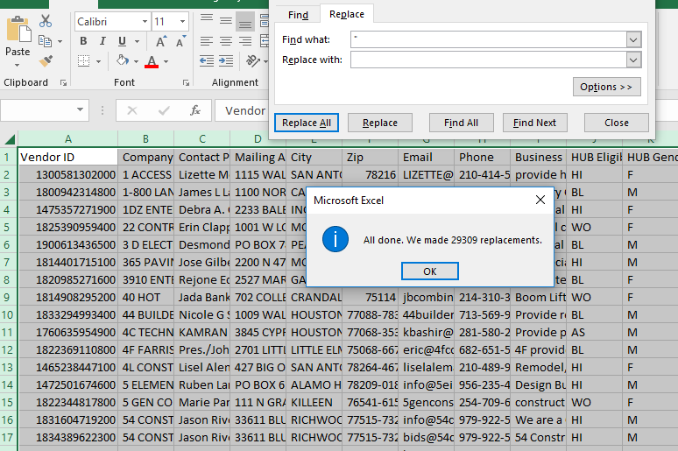

HUB Search by Business Category – Convert to Excel
Step 9.
Step 10.
Type “ (quotation marks) into the “Find what:” “box and leave the “Replace with:” blank.
Then click Replace All button.
**This action will remove all quotation marks from your spreadsheet.**
All quotation marks have been removed. Click the OK and Close buttons on the two open boxes.
Upon completion of Step 10, you can format the sheet in the method of your choosing.
~end of “Convert to Excel” section~

Slide 23



Commonly Used NIGP Class and Item Codes for Construction Services
031 -- AC/H & Ventilating Equipment, Parts, & Access
135-05 -- Alabaster, Gypsum, etc.
150 -- Builder's Supplies (Window Coverings)
150–25, 26, 27 –- Doors Frames & Hardware
150-49 -- Millwork
150-55, 77, 89 –- Overhead Doors
155-20 -- Canopies
165 -- Commercial Kitchen Equipment
295-48, 70 –- Elevator/Equipment Lift
330 –- Fencing
340-08 -- Cabinets & Covers (For Fire Extinguishers, Fire Hose & Racks, Valves, etc.)
340-16 -- Fire Alarm Systems, Power Sirens, & Controls
401–6, 18, 30; 420-11, 415-39, 40 –- Lab Casework
420-04 -- Auditorium, Stadium, Team Seating Furniture, & Portable Bleachers
440 –- Glass & Glazing
450 –- Hardware
450-92 -- Wire & Cable Mechanical
493-96 -- Water Quality Basins
560-39 -- Cranes (Except Automotive, Road, & Bridge Building)
570 –- Specialties
670 -- Plumbing Equip, Fixtures & Supplies
680-02 -- Access Control Systems & Security Systems
725-54 -- Project Site Security
770-64 -- Roofing, Concrete Tile [See 135-74 for Clay Roofing Tile]
801 -- Project Signage (Signs, Materials, Equipment, & Related Supplies)
803 –- Sound Reinforcement Systems
805-17 -- Athletic Field Markers, Goal Posts, Bases, Goals, etc. (Incl. Ath. Field Striping Machines)
805-63 – Scoreboards
805-73 -- Stadium Lighting Equipment and Light Poles [See Class 285 for Lamps]
805-81 -- Track Equipment (Including Pedometers, Pole
Vault, High Jump Equipment, etc.)
838-34 -- Project Site Security (Communication Security System)
870 -- Window Coverings (Venetian Blinds, Awnings, & Shades)
909-37 -- Windows/Storefront/Curtain-wall
909-34 -- Conveying Systems (Elevators, Lifts etc.)
910-03, 09, 25, 39 –- Final Clean
910-17 – HVAC,Lighting,Utilities,Install/Maintain/Repair Srvcs
910-22 -- Sprayed Fireproofing
910-36 -- AC-HV Maintenance & Repair Services
910-51 –- Turnkey Concrete
910-54 -- Painting, Maintenance & Repair Services (Including Caulking)
910-60 –- Mechanical
910-78 –- Waterproofing & Sealants
912-20 -- Construction Fire Protection (Fire Escapes)
912-40 -- Abatement & Demolition
912-44 -- Excavation/Grading/Erosion Control/Tree Protection
913-94,95,96 -- Paving
914-27 –- Carpentry
914-38 -- Electrical
914-44 -- Flooring & Flooring Specialties
914-50 -- HVAC- Heating, Ventilating, & Air Conditioning
914-55- Masonry (Concrete & Structural Masonry)
914-61- Painting & Wallpapering
914-64- Drywall-Acoustical Ceilings
914-68 – Plumbing
914-73 - Roofing & Siding (required window washing access.)
914-79- Structural Steel/Secondary Steel/Misc. Metals
914-80 Stucco (Masonry/Stone/Stucco/Plaster)
914-83- Tile & Marble Work, All Types
914-88 - Wood (Millwork/Casework/ Architectural Wood Work)
915-97 - Telecomm/Data and AV/Security(Wiring Services Data/Voice)
918-73 - Landscaping/Irrigation (Consulting)
918-93 - Project Site Security (Security/Safety Consulting)
929-33 - Cranes- Backhoe, Dragline, Clamshell etc. Maintenance & Repair
931-30 Cafeteria and Kitchen Equipment, Commercial, Maintenance and Repair
934-64 -Plumbing Equip. & Fixtures, Maintenance & Repairs
936-33- Fire Protection Equipment & Systems Including Fire Hydrants, Fire Sprinkler Systems, Smoke Detectors, Jaws of Life, Fire Protection Material Treatment, etc.
Maintenance and Repair
958-95- Site Utilities
958-96 - Waste Management Services
962-37 Flagpole
967-02 - HVAC Equipment & Manufacturing Services
967-30 Plastering
975-26 - Cranes & Buckets Rental or Lease
988-52-Landscaping (Including Design, Fertilizing, Planting etc.) But not Grounds Maintenance or Tree Trimming Services
990-11 - Safety Training & Awareness Services

Slide 24


Commonly Used NIGP Class and Item Codes for General Commodities/ Services
946 - Accounting Services 910-39 - Custodial Services 924 - Learning/ Educational Training
918-04 - Accting Services (Consulting) 545-29 - Custodial Supplies 961-50, 918-24 - Legal Services
915 - Advertising Services 962-35 - Custom Picture Framing 918-76, 961-53 - Marketing Services
906 - Architectural Design Services 962-60 - Event Planning/Services 910-59 - Pest Control
925 - Engineering Services 915-96 - Graphic/Web/MM Design 037-52, 037-78, 715-30 - Promotional Products
962-46, 939-06, 915-09 – A/V Services 962-39 - Hauling Services 946-15, 918-89, 958-53, 958-83, 971-63 - Real Estate
918-04 - Auditing Services 545-29 - Industrial Supplies 918-93, 920-37, 990 - Security Services
915-20 - Call Center Services 920-66 - IT Services/ Support 680-02 - Security Systems
961-15 - Catering 925-86 - Land Surveying 838, 939-72, 915-79 - Telecom./Data Services
918 - Consulting Services (all types) 988-52 - Landscaping Services 962-69 - Temp Services
915-09, 915-82 - Video Production

