Slide 1
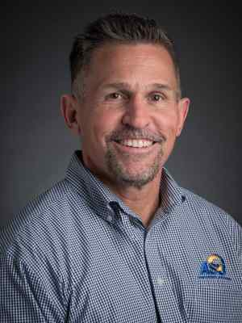

Director of Risk & Emergency Management
325-486-6725
sam.spooner@angelo.edu
Facilities Management Building, Room 119
Notes:
Hi, I’m Sam Spooner, Director of Risk and Emergency Management. As part of this state mandated training, I will be taking the next few minutes to cover some topics important to identifying and mitigating risks while hosting events on or off campus.

Slide 2
Events on or off Campus
Know the risks that come with hosting your event:
  Are there any know hazards? How can the hazards be eliminated or mitigated?
  What is the risk of injury or property damage? How can the risk be mitigated?
  Will the event require participants/attendees to sign waivers (e.g. mechanical bull at Fall Fest)
  Please consult EHSRM for risk elimination and mitigation ideas
Notes:
For each event hosted on or off campus, an activity coordinator is recommended. The activity coordinator will assess the risk of hosting each of the event’s activities. Do any of the activities have known hazards or risks for injury, damage to property, or damage to the organization’s reputation? If so, how can the hazards and risks be eliminated or mitigated.
Plan on the need to have release forms for events on ASU property. They will be required for events and activities with elevated risk. You will need a process for ensuring that participants have signed the form and using a wrist band is a common practice. The release forms ASU uses have been reviewed by General Counsel and include assumption of risk, release from liability, and indemnification.
Please consult our office for risk elimination and mitigation ideas.

Slide 3

When Hosting an Event or Meeting
Conduct a Site Survey
Assess the condition and size of the facility
Locate fire extinguishers, evacuation routes, and fire exits
Is the facility equipped with smoke detectors, emergency lighting, and sprinklers?
Be sure participants know emergency procedures
Locate utilities shut off and/or know who to call for assistance
Notes:
Prior to hosting an event, please conduct a site survey of the location/venue to evaluate its condition and capability to handle the size of the event. In addition, identify the locations of fire extinguishers, evacuation routes, and fire exits. Also, take note of whether or not sprinklers, smoke detectors, and emergency lighting are present. Be sure to let people know the emergency procedures for the location and locate utility shutoffs and/or know who to call for help.

Slide 4
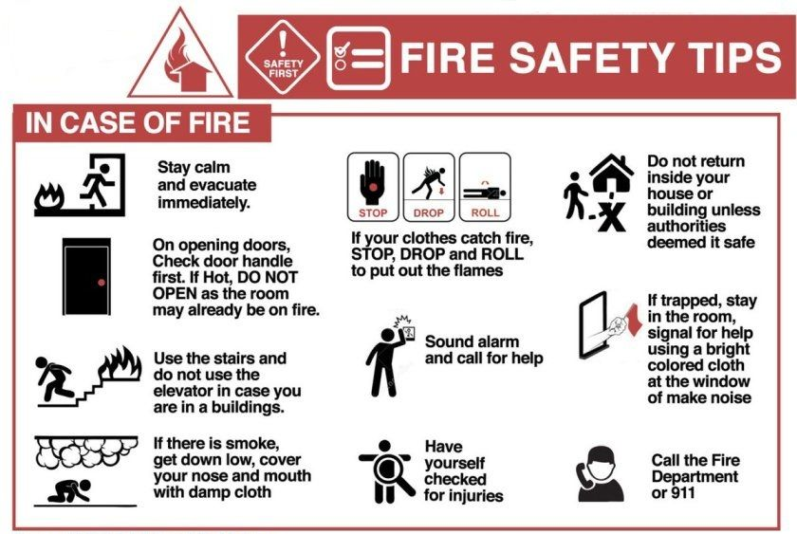
Students and RSOs are required to follow fire and safety codes within building and when hosting events on or off-campus
Monitoring organization activities and implementing controls and procedures to proactively reduce risk and minimize the consequences of an incident and/or loss
TxEd § 51.9361
Student Organization Risk Management
Notes:
All students and RSOs are required to follow fire and life safety codes when hosting events on or off campus. This means you must actively monitor activities throughout the event to reduce risk and minimize the consequences of an incident should it occur..

Slide 5
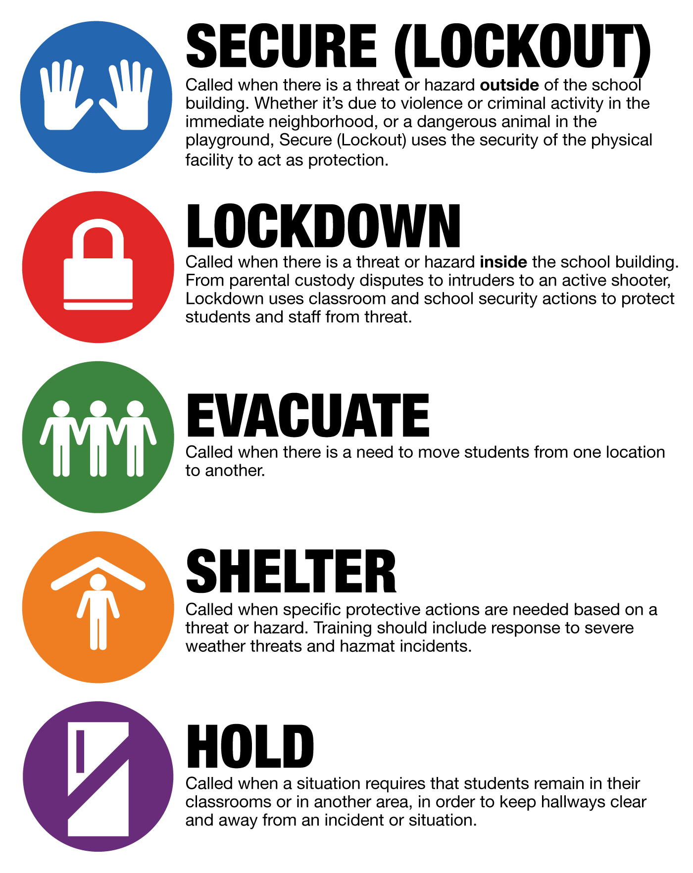
Plan for Emergencies
Develop contingency plans in case of :
Fires
Inclement weather (Lightening, Tornado, Hail, Floods)
Utility outages (Electricity, Gas, Water)
Medical Emergencies
Report unsafe conditions: https://www.angelo.edu/live/forms/42-report-unsafe-conditions-on-campus
Report Specific Facts | Location Description of emergency Nature of injuries or damage
Notes:
Prior to hosting an event, develop emergency contingency plans and share those plans with RSO leaders for fires, inclement weather, utility outages, and/or medical emergencies. The goal is to have discussed and know what to do if the unexpected does actually happen.

Slide 6

Travel Safety
Notes:
I’m now going to move into travel safety.

Slide 7
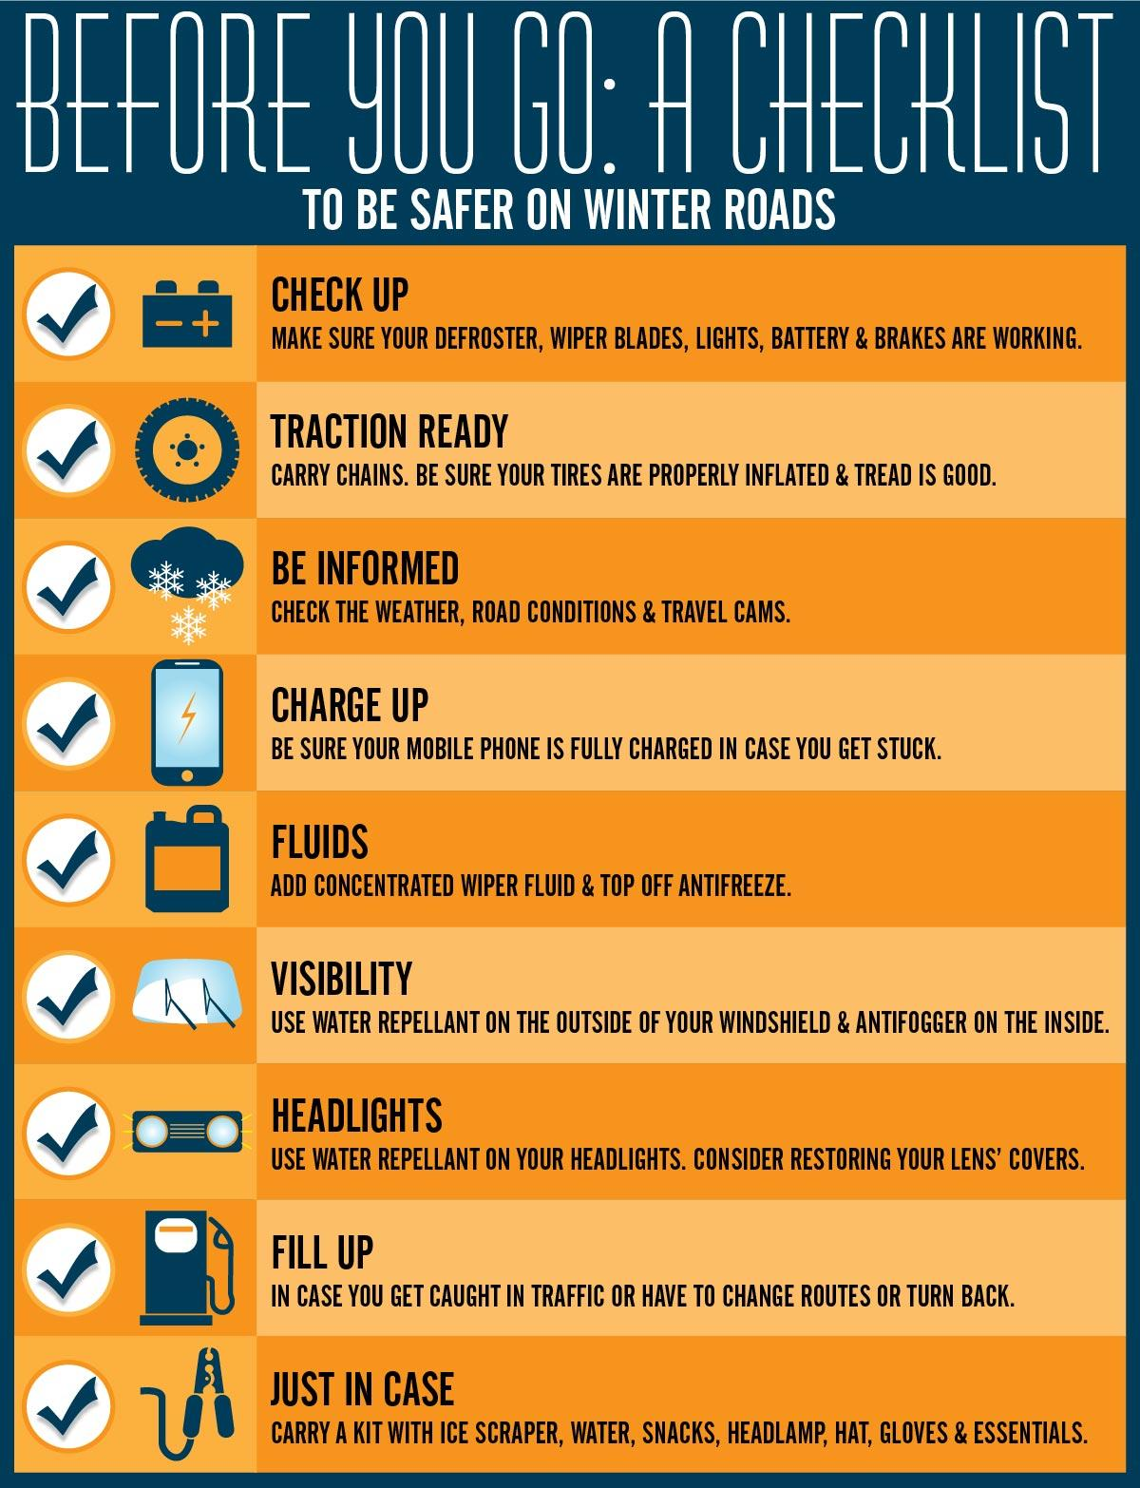
If you are driving:
Consider the following:
Vehicle condition
Vehicle loading
Fatigue
Distractions
Emergency expenses
Length of trip and number of drivers
Weather and road conditions
Notes:
Here are some things to think about if you are driving.
Consider alternative methods of transportation, especially if going long distance in short time frame
Complete a vehicle safety check, but anticipate or prepare for emergency expenses associated with travel
Plan to take a 15 minute break for every two hours of driving or 100 miles.
When assigning someone to perform a task involving driving, consider their physical and mental state
Consider the length of the trip and the number of available drivers
Check weather and road conditions prior to departure.. Consider the risk associated with being stranded during severe weather and pack an emergency kit.
Remember that students must comply with the Student Code of Conduct at all times while travelling::
All drivers and passengers must comply with all applicable traffic laws and regulations. Drivers should act responsibly and use sound judgment.
Drivers must not drive under if impaired or under the influence or transport or possess alcoholic beverages, illegal drugs, unauthorized firearms or other types of weapons.
Drivers and passengers must wear seat belts at all times. The number of occupants in the vehicle must not exceed the number of seat belts.

Slide 8

If your RSO is traveling
Angelo State OP 70.09:
An employee (faculty, staff, teaching assistant or graduate assistant) must be accountable for out-of-town trips involving departmental student groups or sponsored student organizations and ensure that all travel documents are completed prior to travel.
An accountable employee must accompany the students unless prior approval to travel without accompaniment is granted by the appropriate vice president on the Student/Group Travel Form.
Notes:
Based on ASU Operating Policy 70.09, which I recommend you review, the general requirements for the student travel process include:
An employee (faculty, staff, teaching assistant or graduate assistant) must be accountable for out-of-town trips involving departmental student groups or sponsored student organizations and ensure that all travel documents are completed prior to travel.
An accountable employee must accompany the students unless prior approval to travel without accompaniment is granted by the appropriate vice president on the Student/Group Travel Form
Student Organizations interested in traveling throughout the semester must have one member or advisor who is traveling attend Risk Management Training
Organizations must complete the Student Travel Packet and Individual Travel Forms on the RSO website for all travel 10 business days prior to traveling.
Students travelling must be enrolled, in good standing, and at least 18 years of age
Students must have personal automobile insurance and current registration as required by state law if a personal vehicle is used
and as noted earlier, students must comply with Student Code of Conduct at all times.

Slide 9
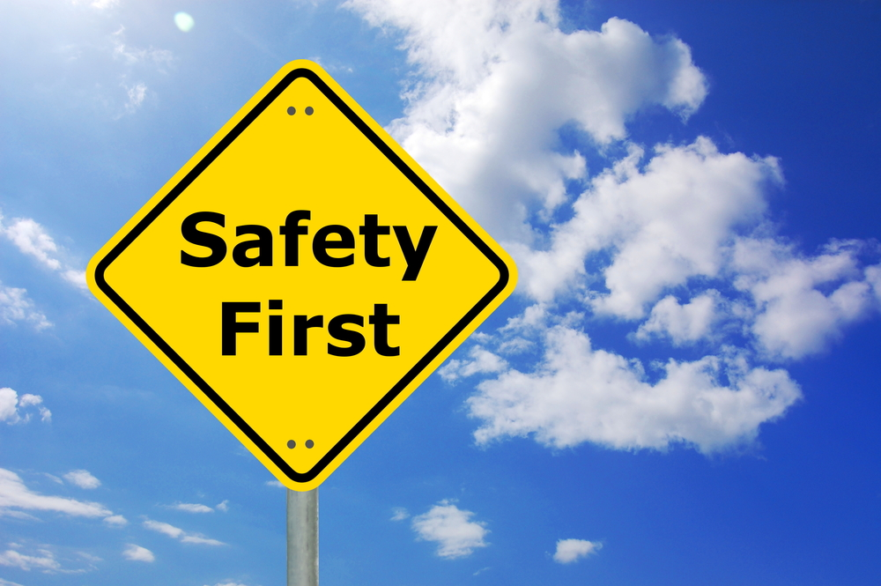

Have each trip participant complete a "Student Activity Release Form" and/or “Student Activity Release Form Private Vehicle” return it to the department administrator who is responsible for retaining the releases.
Complete Clery Travel Information via Chrome River application
Notes:
Each trip participant must complete a "Student Activity Release Form" and/or “Student Activity Release Form Private Vehicle” and return it to the department administrator who is responsible for retaining the releases. In addition, please complete the Clery Travel Information via the Chrome River application. The advisor or RSO representative should organize all documentation to ensure compliance

Slide 10
Adopting a
Risk Management Policy
https://www.angelo.edu/administrative-support/environmental-health-safety-and-risk-management/
Notes:
I’m going to discuss adopting a risk management policy for event activities and how to use a risk management matrix to determine the likelihood and severity of an incident..

Slide 11
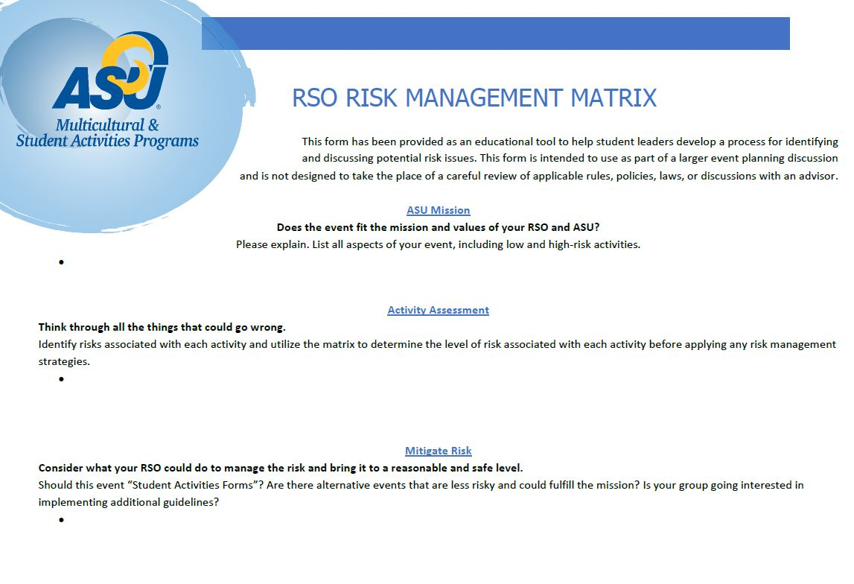
According to State Law
Registered Student Organizations must:
Identify risks that could occur for each activity of an event
Identify ways to reduce and mitigate risks that could lead to personal injury and/or damage to property
Create a plan for what to do if an emergency situation occurs
Notes:
According to State Law, RSOs need to actively reduce the severity of risks and probability that something will go wrong. This is why an event activity coordinator should be assigned.
The activity coordinator needs to:
Identify risky behavior, activities, and hazards
Assess the probability of adverse outcomes
Identify and implement controls to eliminate or reduce the risks and hazards
Reassess the activity after the risks and hazards have been managed
and create an emergency response plan should an incident occur

Slide 12
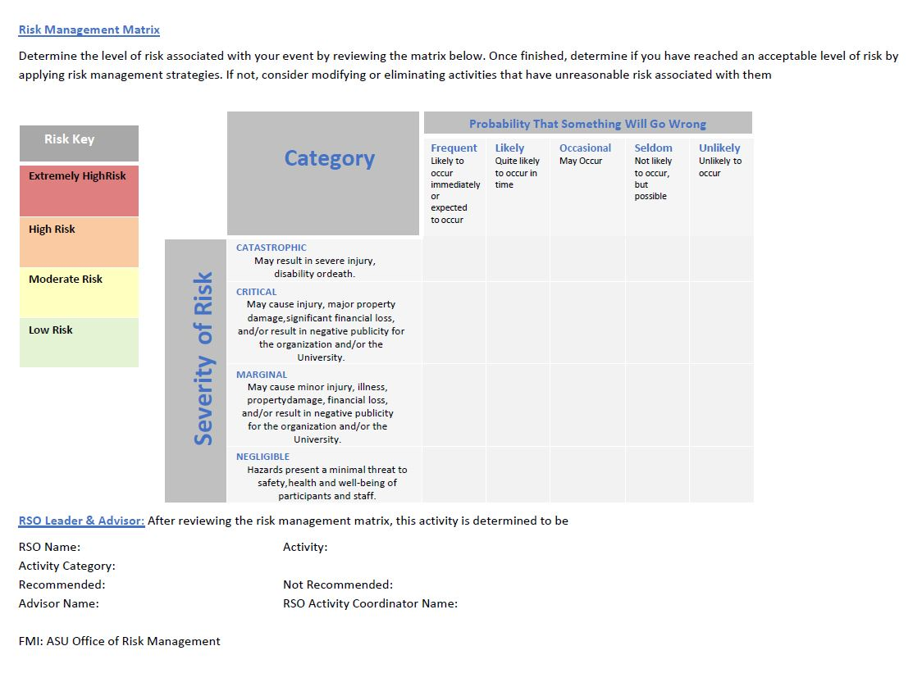
Policy must include
Standards to reduce the risks during:
Community service activities
Fundraising activities
Socials
Traveling
Other events
Notes:
A Risk Management Matrix is a simple tool to use for assessing the severity and likelihood of an incident. Determine the level of risk associated with your event activities by applying the matrix shown on the slide. The goal is to have unlikely and negotiable (low) risk activities. Once finished, determine if you have reached an acceptable level of risk by applying risk management strategies. If not, consider modifying or eliminating activities that have unreasonable risk associated with them.
For example, deciding to drive to Corpus Christi from ASU after a full day of classes and four hours at a part time job would be taking unnecessary risk. When applying the risk matrix, the likelihood of falling asleep at the wheel is high and the severity of an incident is catastrophic As the activity coordinator, you could mitigate those risks by getting a good night's sleep and leaving in the morning.
As an RSO, you have a responsibility to provide safe and fun activities for yourself and for participants.
*for the video production: https://www.youtube.com/watch?v=-E-jfcoR2W0

Slide 13

Don’t get sued!
In case that anything does happen during events you, your organization, and/or its officers can be sued
Protect yourself, your organization, and the institution by creating a plan and Risk Management Policy
If you are hosting an activity where individuals may get injured:
Reduce probability of injury
Consult EHSRM
Use activity release forms!
Have a plan
Notes:
Remember to consult EHSRM for risk reducing strategies if you are hosting an activity where injury or damage to property may occur. Our goal is to say yes to an event, but only if it maintains the health and safety of the participants involved.

