Slide 1

Essentials of
Laboratory Safety for Students
Presented by the Office of
Environmental Health, Safety, & Risk Management

Slide 2
Course Objectives
Students who successfully complete this training will be able to:
Properly handle, store and dispose of chemical substances
Apply risk assessment strategies in a laboratory setting
Identify the chemical exposure routes
Properly prepare for work in the lab
Determine appropriate emergency responses and first aid procedures

Slide 3
Laboratory Safety Overview
General Laboratory Procedures
Chemical Handling Procedures
Personal Protective Equipment
Chemical Exposure Procedures
Safety Equipment
Emergency Procedures

Slide 4
Developing a Culture of Safety
Safety must be important to laboratory administrators, workers, and students
Safety and health must be incorporated into laboratory processes
Nurture basic attitudes and habits of prudent behavior
Consider the health, physical, and environmental hazards to be used
Develop a culture of habitual risk assessment, planning, and considering of worst case scenarios

Slide 5
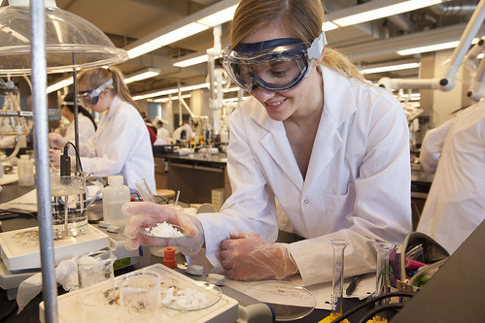
Safety Plans
Chemical Hygiene
Bloodborne Pathogens
Environmental and Regulatory Compliance
General Safety
This Photo by Unknown Author is licensed under CC BY-NC-ND
Respiratory Protection
Biosafety
Hazardous Waste
General and specific plans contain more detailed information and complement each other to improve the safety and health of students, faculty, and staff, and support a strong learning environment

Slide 6
Minimizing Exposures and Risks
Risk Assessment
What are the hazards?
What is the worst thing that could happen?
What can be done to prevent this from happening?
What can be done to protect from these hazards?
What should be done if something goes wrong?
Identify biological agents, amounts, circumstances of experiment
Evaluate hazards posed by biological agents and experimental conditions
Evaluate containment requirements
Select appropriate controls
  Engineering controls are best
  Administrative and work practice controls
  PPE where exposures remain
Implement and monitor for effectiveness
Information Sources
Safety Data Sheets (SDS)
Source Safety Summaries
Biosafety Plan
Institutional Biosafety Committee
ABSA Biosafety Links
Official Websites
CDC
NIH
OSHA
USDA

Slide 7
General Work Procedures
Do not work in a laboratory alone or without supervision
Perform experiments or work precisely as directed by a lab supervisor
Immediately report spills, accidents, or injuries to a supervisor
Do not leave experiments unattended unless directed by a supervisor
Do not remove any equipment or chemicals from the laboratory unless directed by a lab supervisor

Slide 8
General Lab Safety Procedures
Turn off all heating apparatus, gas valves, and water faucets not in use
Make sure flammable solvents are not in the area when lighting a flame and do not leave lit burners unattended
Properly discard all sharps
Properly clean up and dispose of broken glass in appropriately marked container
Be careful when handling hot glassware and apparatus in the laboratory
Keep the floor clear of all objects (ice, liquids, small items, backpacks, etc.)
Always wear appropriate personal protective equipment (PPE)

Slide 9
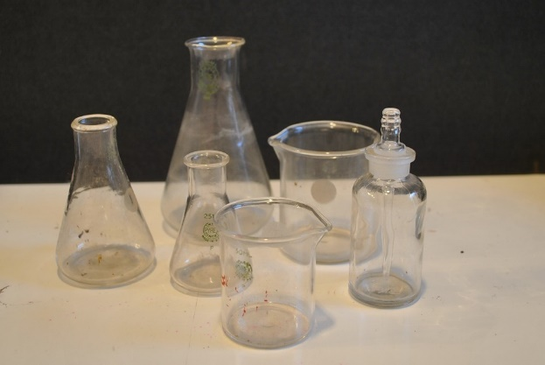
Laboratory Housekeeping
Work areas shall remain clean and uncluttered
Plan and organize your workspace
Path to safety equipment kept clear
Breaker panels, fire extinguishers, & eye wash/shower stations require 3’ clearance & clear path
Workplace and lab equipment is clean and sanitary
Clean, return, and properly store tools and equipment
You are responsible for the condition of your lab!
This Photo by Unknown Author is licensed under CC BY-SA-NC

Slide 10
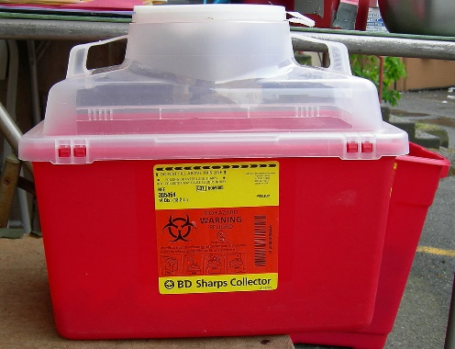
Sharps Containers
Dispose of sharps in approved sharps containers
Never recap needles
Broken glass receptacles will be marked and provided in labs; broken glass does not go in sharps containers
Sharps containers should be disposed of when ¾ full
This Photo by Unknown Author is licensed under CC BY-SA

Slide 11


Lab Distractions
Reduce risk for accidents
Avoid distracting cell phones, media players, & ear buds
These devices can also become contaminated if working with hazardous/infectious materials

Slide 12
Chemical Handling Procedures
Know what chemicals you are using. If you don’t know, ASK your lab supervisor!!!
Inform lab supervisor of known sensitivities to particular chemicals
Consider all chemicals to be hazardous unless instructed otherwise
Always use proper safety equipment and personal protective equipment
Contain spills from the outside in and immediately notify a lab supervisor
Properly dispose of chemical waste in designated containers
Do NOT dispose of chemicals or chemical waste in sinks or drains

Slide 13
Chemical Storage Procedures
Properly store chemicals when not in use
Store chemicals by hazard classification
All chemicals must be labeled
Securely cap and check integrity of chemical container
Containers should not be stored above eye level
Store heavier containers on lower level shelves
Store flammable chemicals in a fire-rated cabinet
Do not store combustible materials in flammable cabinets

Slide 14
Hygiene Practices
Keep hands away from face, eyes, mouth, and body while in laboratory
Never bring food or drinks into a laboratory or chemical storage area
Do not apply cosmetics while in a laboratory or chemical storage area
Remove any protective equipment (gloves, lab coats, goggles, etc.) if contaminated, to decontaminate skin, & before leaving the laboratory
WASH HANDS!!
When you arrive at the laboratory
After handling materials/removing gloves
Before leaving the laboratory
Wash hands for a minimum of 30 seconds

Slide 15
Safety Data Sheet (SDS)
The SDS contains information regarding the proper procedures for handling, storing, and disposing of chemical substances
An SDS exists for all hazardous chemicals
Lab supervisors are responsible for ensuring students are aware of the chemical composition, toxicity, reactivity, hazards, exposure controls, and first aid measures when handling or working with a substance
Students should consult the SDS “Accidental Release Measures” prior to handling a substance

Slide 16
What are the features of a SDS?
Chemical manufacturers & importers must obtain or develop a safety data sheet for each hazardous chemical they produce or import
The SDS must include information such as the properties of each chemical; the physical, health, and environmental health hazards; protective measures; and safety precautions for handling, storing, and transporting the chemical
Sections 1 through 8 contain general information about the chemical, identification, hazards, composition, safe handling practices, first aid measures, and emergency control measures (e.g., fire fighting)
Sections 9 through 11 and 16 contain other technical and scientific information, such as physical and chemical properties, stability and reactivity information, toxicological information, exposure control information, and other information including the date of preparation or last revision

Slide 17
Standard 16 Sections of a SDS
Section 1: Identification of the substance or mixture and of the supplier
Section 2: Hazard identification
Section 3: Composition/information on ingredients Substance/Mixture
Section 4: First aid measures
Section 5: Firefighting measures
Section 6: Accidental release measures
Section 7: Handling and storage
Section 8: Exposure controls/personal protection
Section 9: Physical and chemical properties
Section 10: Stability and reactivity
Section 11: Toxicological
Section 12: Ecological information
Section 13: Disposal considerations
Section 14: Transportation information
Section 15: Regulatory information
Section 16: Other info including information on preparation & revision of SDS

Slide 18
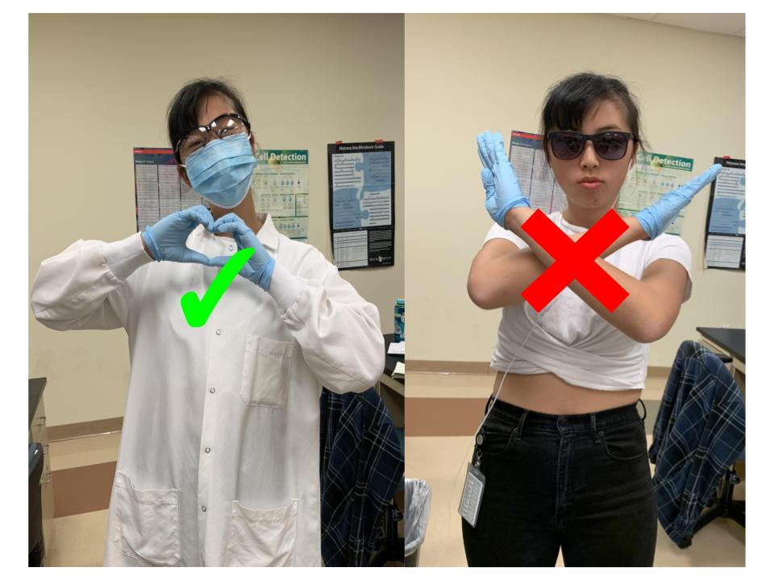
Personal Protective Equipment (PPE)
Section 8 of SDS
Proper PPE
Improper PPE
This Photo by Unknown Author is licensed under CC BY

Slide 19
PPE Requirements
PPE is mandatory in all areas where there is potential for exposure to hazards or injury
ALWAYS check with your laboratory supervisor for instructions regarding specific PPE requirements as they can vary

Slide 20
Eye protection: Safety Glasses
Safety glasses provide impact protection from projectiles
Side shields provide additional protection from flying objects and chemical splashes
Recommend not wearing contact lenses in the laboratory

Slide 21
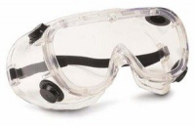
Eye protection: Goggles
Goggles provide the best protection for splashes of corrosive liquids or flying particles
Use during activities such as washing glassware in an acid solution or grinding materials
Can be worn over prescription glasses
This Photo by Unknown Author is licensed under CC BY

Slide 22
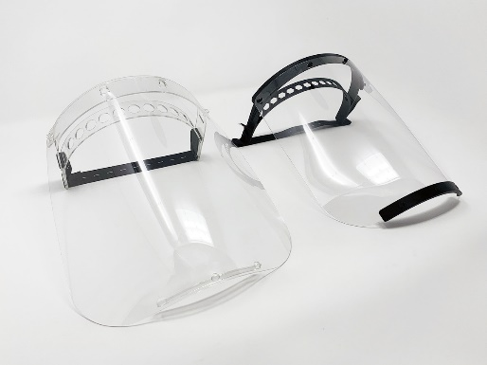
Eye Protection: Face Shields
Wear a face shield when conducting reactions that have a potential for explosion or mixing strong caustics or acids
Face shields provide frontal impact and splash protection for the face
Always wear goggles with a face shield to protect the eyes from exposure
This Photo by Unknown Author is licensed under CC BY-SA

Slide 23
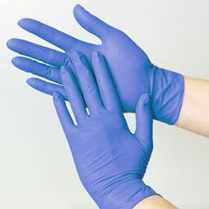
Hand Protection: Gloves
Wear gloves when handling hazardous materials or chemicals
Gloves help prevent chafing, burns, cuts, dermatitis, and chemical sensitization
Select appropriate gloves based on compatibility with materials and breakthrough characteristics
Latex allergies can develop
ALWAYS!
Inspect for holes or damage prior to use
Wash prior to removing
Remove before leaving work area
This Photo by Unknown Author is licensed under CC BY

Slide 24


Hearing Protection
Earplugs, muffs, and canal caps are used to reduce exposure to noise
Eyeglass earpieces reduce the effectiveness of muffs
Do not use headphones or ear buds as a substitute for hearing protection as this may accelerate hearing loss
Use double hearing protection (earplugs and muffs) when encountering extremely high decibels or prolonged exposure to noise
This Photo by Unknown Author is licensed under CC BY-NC

Slide 25
Breathing Protection
Whenever possible, conduct work in paint booths or under fume hoods or exhaust fans to minimize hazards
Select respirator and cartridge or filter type to match possible exposure
Contact EHSRM to schedule medical evaluation/fit testing if respirator is required
Respirators provide inhalation protection filtering out hazardous or contaminated particulates or gases

Slide 26

Skin Protection: Apparel
Wear long sleeve shirts, long pants, and closed-toe shoes to protect skin, including toes and heels
Lab coats and aprons provide additional protection to skin and clothing from exposure to hazardous or infectious materials
Avoid wearing baggy or loose clothing
Remove or restrain loose jewelry
Keep long hair tied back and away from flames
Lab coats and aprons should be removed prior to leaving the lab
This Photo by Unknown Author is licensed under CC BY-NC

Slide 27
Chemical Exposure Routes
A chemical can enter the body through different routes
These different routes of exposure and the types of exposure (acute or chronic) can affect the chemical’s toxicity
The most probable (primary) route(s) of exposure to a chemical will be identified in the SDS
Three principal routes of exposure include:
Dermal exposure
Inhalation
Ingestion

Slide 28
Chemical Exposure: Dermal
While intact skin is an effective barrier for many chemicals, it is a common route of exposure
Organic chemicals are more likely to penetrate skin than inorganic chemicals
Chemicals are absorbed much more readily through injured, chapped, or cracked skin, or needle sticks than through intact skin
The toxicity of a chemical depends on the degree of absorption that occurs once it penetrates the skin
Once the skin is penetrated, the chemical enters the blood stream and is carried to all parts of the body
Depending on substance and length of exposure, effects of dermal exposure can range from mild temporary discomfort to permanent damage

Slide 29
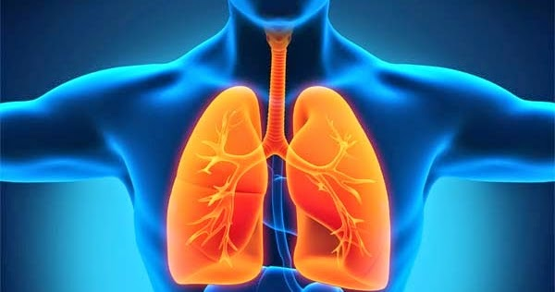
Chemical Exposure: Inhalation
Inhalation is another route of chemical exposure
Unlike the skin, lung tissue is not a very protective barrier against the access of chemicals into the body and can also be damaged by chemicals
Chemicals in the form of gases, vapors, mists, fumes, and dusts entering through the nose or mouth can be absorbed through the mucous membranes of the nose, trachea, bronchi, and lungs
Chemicals, especially organic chemicals, enter into the blood stream quickly
This Photo by Unknown Author is licensed under CC BY

Slide 30

Chemical Exposure: Ingestion
Ingestion involves chemicals entering the body through the mouth
They may also enter through contaminated objects, such as hands or food that come in contact with the mouth
Chemical dusts, particles, and mists may be inhaled through the mouth and swallowed
Absorption of the chemicals into the bloodstream can occur anywhere along the length of the gastrointestinal (GI) tract

Slide 31

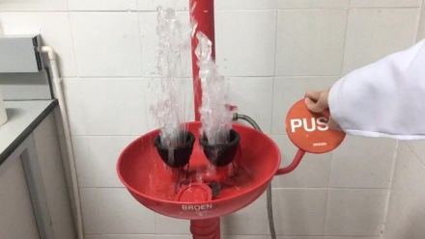
Chemical Exposure First Aid Measures
Section 4 of SDS
Eye Contact: Immediately flush eyes with plenty of water for at least 15 minutes, lifting the upper and lower eye lids occasionally. Seek medical treatment immediately.
Skin Contact: In case of contact, immediately flush skin with plenty of soap and water for at least 15 minutes while removing contaminated clothing and shoes. Seek medical treatment immediately.
Inhalation: Evacuate victim to fresh air immediately and request medical assistance.
Ingestion: Aspiration hazard. If swallowed, DO NOT INDUCE VOMITING. Immediately call Poison Control Center and seek medical assistance.
This Photo by Unknown Author is licensed under CC BY-SA

Slide 32
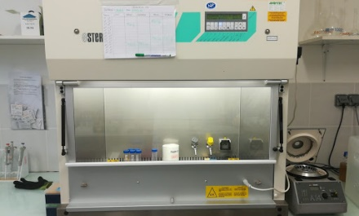
Safety Equipment: Fume Hood
Use a fume hood to control exposure to toxic or flammable vapors, gases, and aerosols
Keep hood sash closed when not in use
Do NOT store chemicals in hoods
Verify adequate airflow before beginning work
Work with fume hood sash at or below the maximum height indicator
Work at least 6 inches from the face of the hood
If equipment must be used or stored in the hood, elevate it on blocks to allow air to flow beneath it
This Photo by Unknown Author is licensed under CC BY

Slide 33
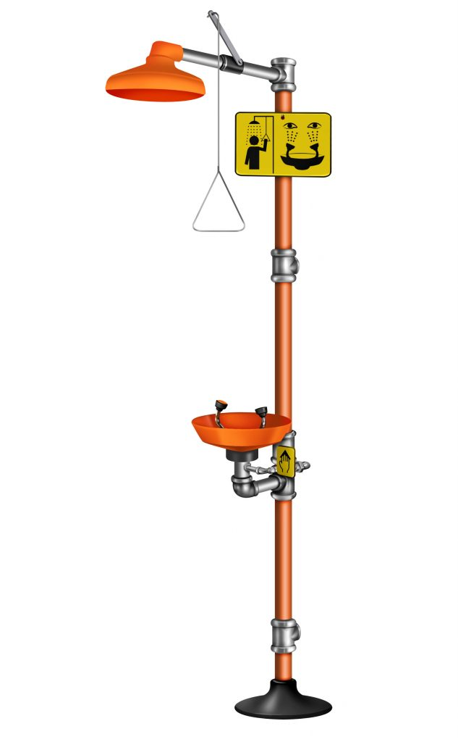

Safety Equipment: Shower / Eye Wash
If chemicals come into contact with skin or eyes, immediately flush with water for at least 15 minutes
This Photo by Unknown Author is licensed under CC BY-SA
This Photo by Unknown Author is licensed under CC BY-SA
Emergency Shower
Eye Wash Station

Slide 34
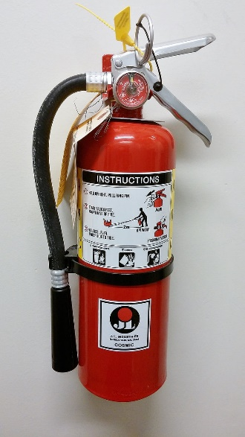
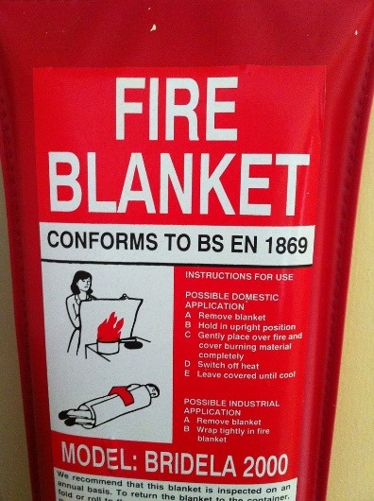
Fire Safety Equipment
Pull pin
Aim at base
Squeeze handle
Sweep side to side
Laboratory fire blankets are designed to extinguish fires involving chemicals by being wrapped around a person whose clothes are on fire
Fire extinguishers should be used for fires the size of a wastebasket and typically discharge in 30 seconds
This Photo by Unknown Author is licensed under CC BY

Slide 35

Emergency Procedures
Know emergency contact information and reporting procedures
Reference the Safety Data Sheet (SDS) for material hazards, exposure controls, and first aid measures
Learn location of eye-wash stations, emergency showers, and first aid kits
Become familiar with emergency spill procedures and spill kit locations
Learn procedures for hazardous material contamination
Know the primary and alternate escape routes
Learn location of fire alarm pull stations, fire extinguishers, and fire blankets
Campus Phones
Emergencies
9-911
University Police
9-2071
(325) 942-2071
EHSRM
9-2180 or 9-6725
(325) 942-2180/6725

Slide 36
Chemical Spill Procedures
Immediately alert lab supervisor and caution others to avoid the spill area
Avoid touching, walking in, or breathing in the spill area
Close all hazardous material containers
Turn off flames and other ignition sources
Close sashes and leave fume hoods ON
Turn off electrical equipment/heating devices
Contain the spill from the outside in (use spill kit)
Create a barrier to the spill area
Assist others with First Aid measures noted in Section 4 of SDS

Slide 37



Your Health is In Your Hands
Work smart and be safe in the lab
You have control over your personal health
Protect yourself,
your friends,
and your community!

