Slide 1
Hazardous Communication and
Global Harmonized System (GHS)
Environmental Health, Safety, & Risk Management

Slide 2

Hazardous Communication Course Objectives
ASU students who successfully complete this training will be able to:
Define a hazardous chemical
Identify and read Globally Harmonized System (GHS) labels and Safety Data Sheets
Classify the types of chemicals
Identify hazardous chemical routes of entry into the body
Properly prepare for work with hazardous chemicals
Determine appropriate emergency responses
This Photo by Unknown Author is licensed under CC BY

Slide 3
What Is Hazardous Communications?
People who work with Hazardous Chemical have a “Right to Know”:
What those chemicals are
What hazards are associated with those chemicals
What they can do to protect themselves
How to handle and store products they work with
What to do if they have an emergency working with those chemicals

Slide 4
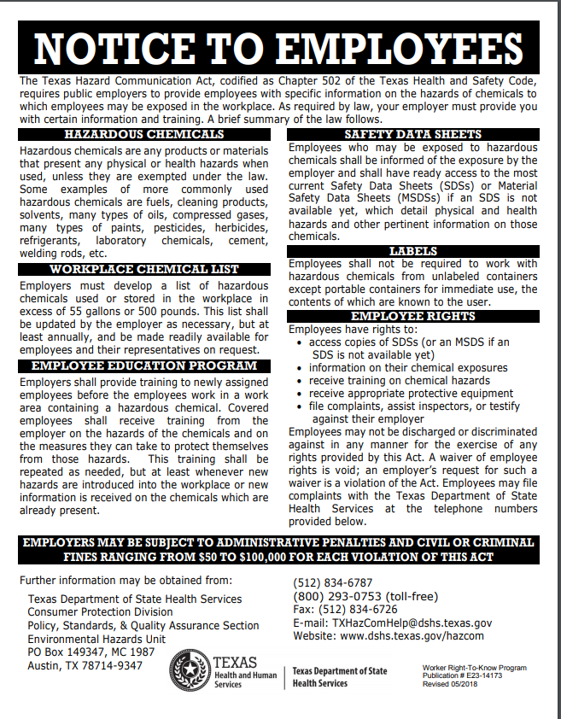
Texas Hazard Communications Act

Slide 5

What Is GHS?
Globally Harmonized System (GHS) of Classification and Labeling of Chemicals - Needed because of global economy
Internationally Developed System to protect workers by using the same criteria (testing procedures, exposure limits, etc.) to determine the hazards of chemicals
Safety Data Sheets must be created based on the same 16 part format
The use of visually based warning symbols (pictograms) on product labels so workers can immediately identify the hazards associated with the products they use

Slide 6

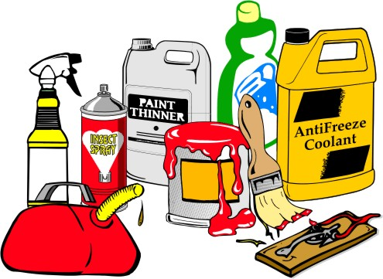
What Is Considered a Hazardous Chemical?
A hazardous chemical is defined by the Occupational Safety and Health Administration (OSHA) as any chemical that is a health hazard or a physical hazard
This Photo by Unknown Author is licensed under CC BY-SA
This Photo by Unknown Author is licensed under CC BY-SA

Slide 7

How Do Hazardous Chemicals Affect The Body?
The affect a certain chemical has on the body
depends on several factors:
The physical form of the chemical
How the chemical enters the body
The amount of chemical that actually enters the body - the dose
How toxic (poisonous) the chemical is

Slide 8
Types Of Chemicals
All chemicals exist in one of three forms:
Solid
Liquid
Gas

Slide 9

Chemical Solids
Solids – Dusts and Particulates
Dust or powder can be released into the air by cutting, drilling, grinding or sanding and inhaled
Dust can also be stirred up by dry sweeping and inhaled
Dust can also be stirred up by dry sweeping and inhaled
This Photo by Unknown Author is licensed under CC BY-SA-NC

Slide 10


Chemical Solids
Solids – Fumes and Fibers
Fumes are extremely small droplets of metal formed when the metal has been vaporized by high temperatures (usually welding)
Some compounds are fibers which can be similar to dusts but they have an elongated shape (like asbestos or fiberglass)
This Photo by Unknown Author is licensed under CC BY

Slide 11
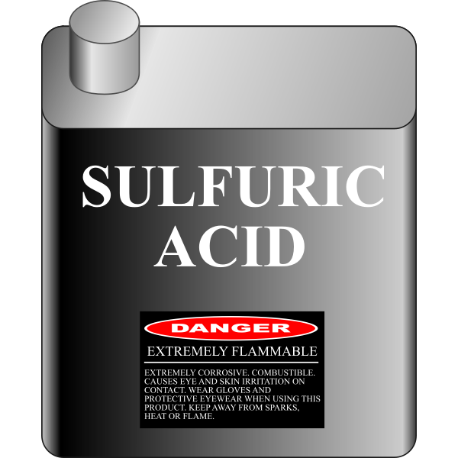
Chemical Liquids
Liquids can come into direct contact with the skin and be absorbed into the body
Liquids can be sprayed and form mists or evaporate and form vapors which can be inhaled
Liquids

Slide 12

Chemical Liquids
Liquids (Mists)
Mists can also
be inhaled
Mists can settle on the skin and be absorbed
Airborne mists can
also settle out and contaminate food
or drink

Slide 13
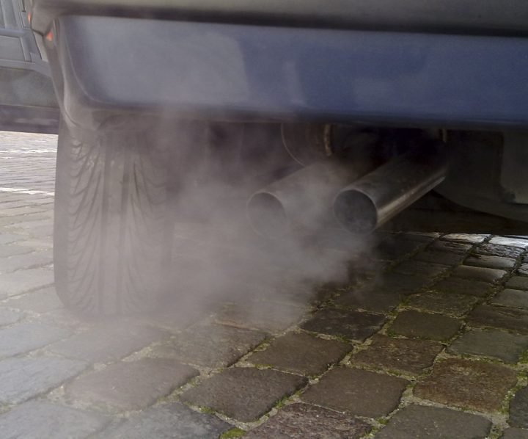
Chemical Gases
Gases
Some can occur naturally
Vapors can form from liquids
Carbon Monoxide, Hydrogen Sulfide, and Ammonia gas are some chemicals that have killed workers in the gas form
This Photo by Unknown Author is licensed under CC BY

Slide 14
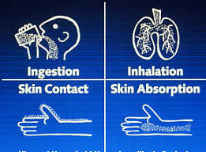
How Chemicals Enter The Body
Routes of Entry:
Ingestion – swallowing the chemical
Inhalation – breathing in the chemical
Absorption – the chemical
soaks through the skin
Skin or eye contact - chemical does external damage to skin or eyes on contact
Injection - sharp object pierces the skin

Slide 15

How Chemicals Enter The Body
Ingestion (Swallowing)
Chemicals that are swallowed are
absorbed in the digestive tract
Chemicals can rub off dirty hands
and contaminate food, drinks or
tobacco products
Chemicals in the air can settle on
food or drink and be swallowed

Slide 16
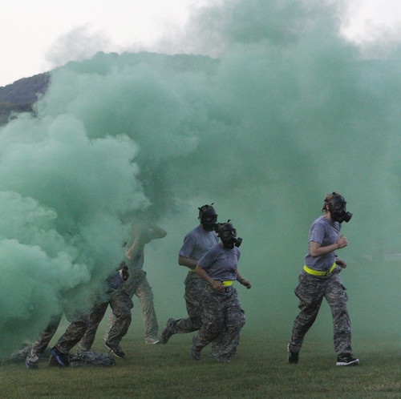
How Chemicals Enter The Body
Inhalation (Breathing)
Airborne chemicals are breathed in
through the mouth or nose
The size of particles or droplets can
affect where the chemical settles in
the respiratory tract
Where the chemical settles in the
respiratory tract determines what
symptoms or diseases will develop
This Photo by Unknown Author is licensed under CC BY-NC-ND

Slide 17

How Chemicals Enter The Body
Skin Absorption
Some chemicals can pass through the skin and be
taken into the body’s systems
Solvents and pesticides
are examples of compounds
that can be absorbed
through the skin

Slide 18
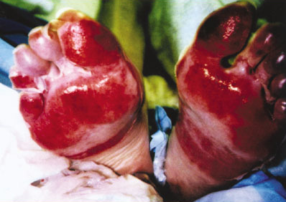
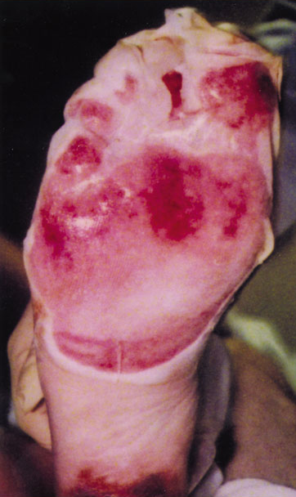
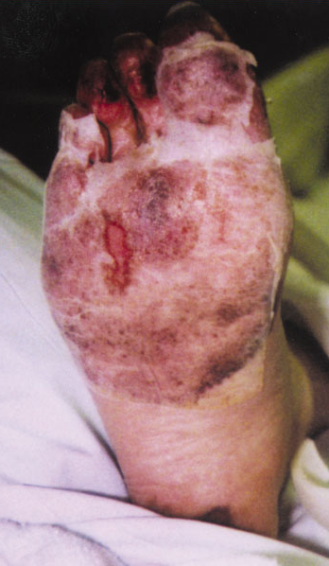
How Chemicals Enter The Body
Skin Contact
Corrosives can cause visible skin burns or damage
The extent of skin damage depends on how long the
corrosive is on the skin and how concentrated the corrosive is
Acute Chemical Burn
1 Day Later
7 Days Later

Slide 19
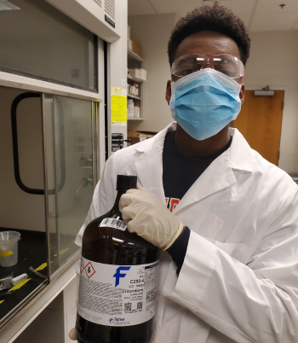
How Chemicals Enter The Body
Eye Contact
Inhalation of corrosive mists or vapors can cause severe
bronchial irritation
Corrosive chemicals are capable of damaging skin, eyes and the respiratory system
This Photo by Unknown Author is licensed under CC BY

Slide 20

How Chemicals Enter The Body
Injection
Some chemicals can pass through the skin and be
taken into the body’s systems thorough a break in the skin
Needles and sharp objects cause injection hazards
This Photo by Unknown Author is licensed under CC BY-NC

Slide 21
Chemical Toxicity
Toxicity: How dangerous are chemicals?
Dose - The effects of any toxic chemical depends on the amount of a chemical that actually enters the body
Acute Toxicity - The measure of how toxic a chemical is in a single dose over a short period of time
Chronic Toxicity – The measure of the toxicity of exposure to a chemical over a long period of time
Lethal Dose - expressed as LD50 or dose at which 50% of a population will die

Slide 22
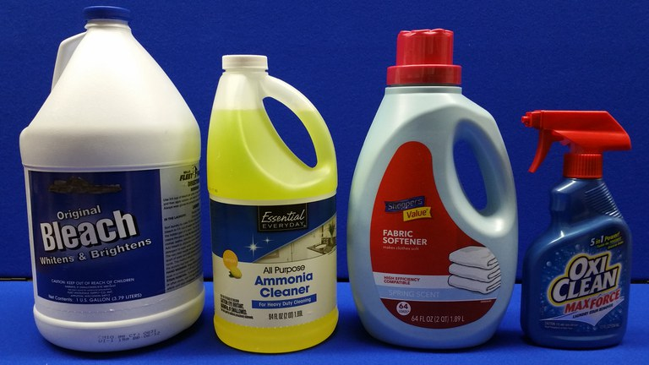
Chemical Toxicity
Chronic Toxicity and Acute Toxicity
Some chemicals will only make you sick if you get an ‘acute” or high dose all at once
Example - ammonia
Some chemicals are mainly known for
their chronic or long-term effects
Example - asbestos
Most chemicals have both
acute and chronic effects
Example – carbon monoxide
This Photo by Unknown Author is licensed under CC BY-SA-NC

Slide 23
Health Hazards
What are some of the things chemicals can do to you?
Carcinogens - these chemicals may give you CANCER
Check to see if the chemicals you are using are on the Department of Occupational Safety and Health (DOSH) carcinogen list for special rules when working with these chemicals
Teratogens - these chemicals hurt unborn babies, or CAUSE BIRTH DEFECTS
Mutagens- these chemicals cause BIRTH DEFECTS and sometimes CANCER in the exposed worker
Sensitizers - these chemicals can cause an ALLERGIC REACTION in smaller and smaller doses, that can be deadly

Slide 24
Chemical Exposure Limits
Chemical Exposure Limits
Many chemicals have exposure limits, or allowable amounts of a chemical in the air without having to wear additional protection
These limits are often called Permissible Exposure Limits“PELs” or Threshold Limit Values “TLVs”
They are based on 8-hour average exposure or ceiling or peak levels
Levels must be kept below these limits for safety
Employers have an obligation to monitor for many of these chemicals or use historical data to estimate PEL

Slide 25

Physical Hazards
FLAMMABILITY
Vapor pressure is a measure of how fast a liquid evaporates.
Flammable Range: The limits of flammability is the range that a mixture of air and vapor is flammable. Chemicals have an upper and lower flammability limit (LFL, UFL).
Air 100%
Air 0%
Too Lean
Too Rich
Methane
0%
Boom!
Methane 100%
5.3% LFL
15.0% UFL
The flash point is the lowest temperature that a flammable liquid can generate enough vapor to form a mixture with air that will ignite.

Slide 26
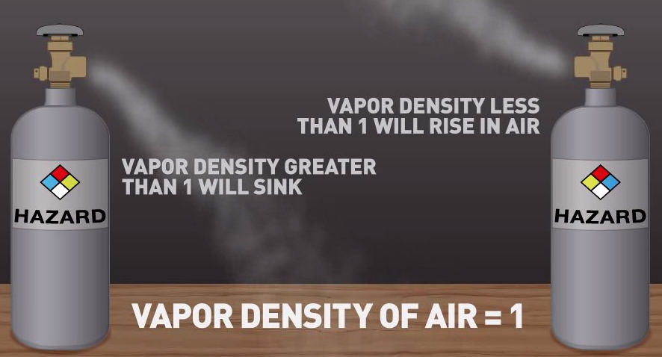
Physical Hazards
Vapor Density

Slide 27

Physical Hazards
Explosions are physical hazards
Explosive; fire, blast or projection hazards by self-reactive substances, substances that can burn without oxygen; or that may explode when disturbed will be labeled with this symbol
Explosions are often caused by pressurized cylinders and can be accelerated by oxidizers
Explosions

Slide 28

This Is All Getting a Bit Technical - How Does It Work With an ASU Student?
This Photo by Unknown Author is licensed under CC BY

Slide 29

Chemicals at ASU
MEET BOB
Engineering Student
Bob’s job is to learn
Bob works with many different kinds of hazardous and non hazardous chemicals
This Photo by Unknown Author is licensed under CC BY

Slide 30


Chemicals at ASU
How can ASU protect Bob from Chemicals?
The Engineering Faculty train Bob on Chemicals, SDS, and Labels with this presentation BEFORE Bob works with hazardous chemicals
Bob is provided access to a list of SDSs for the chemicals he works with, so he that he can double check all procedures
Bob is also trained in the use of the correct Personal Protective Equipment (PPE) such as gloves, safety googles, respirators, etc. for the chemicals he works with
HAZCOM
TRAINING

Slide 31

Hazcom Training- GHS Labels
What does Bob need to know about chemical labels?
Bob learns the chemicals he works with need to come with a warning label
He needs to leave the product in the original container whenever possible
If he puts the chemical in a new container, he needs to put a GHS Label on the container

Slide 32
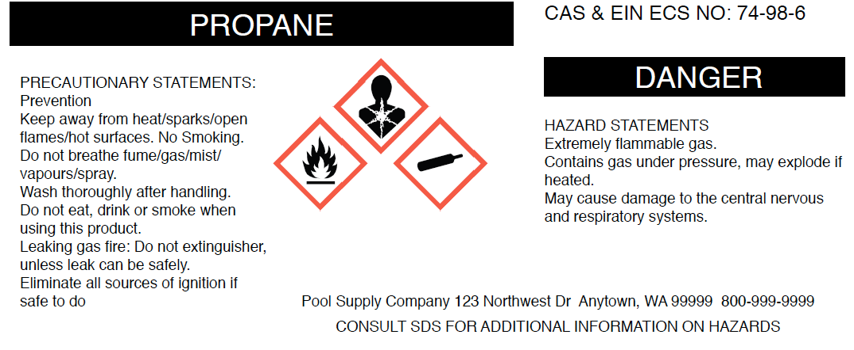
GHS Labels Must Have 6 Items
1. Product Identifier
2. Signal Words help define
how dangerous a chemical is:
  Danger - More Dangerous
  Warning - Less Dangerous
3. Hazard Statements:
Statements that describe the nature of the hazard(s) of a chemical including, where appropriate, the degree of hazard.
4. Pictograms
5. Precautionary Statements:
Recommended measures of prevention, response, storage and disposal.
6. Name, address, and telephone number of the chemical manufacturer, importer, or other responsible party.
1→
2→
5→
3
4
6→

Slide 33

GHS Hazard Communication
What do the 9 Pictograms mean?
Health Hazards
Physical Hazards
Environmental Hazards

Slide 34


GHS Pictograms
Exclamation Mark:
Chemicals that are acutely toxic and that can be harmful or toxic by ingestion, inhalation, or contact with the skin or eyes, often with a small dose
Irritant–irritates the skin or eyes
Skin sensitizer–which is an allergic response following skin contact
Acute toxicity–which may be fatal or cause organ damage from a single short-term exposure
Narcotic effects like drowsiness, lack of coordination, and dizziness
Respiratory tract irritation

Slide 35



GHS Pictograms
Health Hazard:
Chemicals that pose Health Hazards and can cause acute or chronic health effects such as respiratory function damage, cancer, specific organ function damage, sexual dysfunction, fertility problems, birth defects and genetic mutations are represented by this symbol

Slide 36


GHS Pictograms
Skull and Crossbones:
Substances with a hazard of acute toxicity will have this symbol on their chemical label.
Acute toxicity means that exposure to a single dose of the chemical may be toxic or fatal if inhaled or swallowed, or if it comes into contact with the skin

Slide 37


GHS Pictograms
Corrosives: Corrosives, such as acids are chemicals that can be corrosive to metal, skin, or cause damage to eyes can be labeled with this symbol

Slide 38


GHS Pictograms
FLAME:
Flammable solids, gases, aerosols, liquids, or; self-reactive substances and mixtures; pyrophoric, self-heating chemicals; chemicals that ignite when exposed to water and organic peroxides can be depicted with this symbol.
GAS CYLINDER: Gases under pressure may explode if heated. This pictogram would be used for compressed gases, liquefied gases, refrigerated liquefied gases, and dissolved gases. Gases may cause cryogenic burns or injuries.

Slide 39





GHS Pictograms
FLAME OVER CIRCLE:
This symbol represents an oxidizer. Oxidizers are chemicals that cause or help other chemicals to burn by adding oxygen to the chemical process. Oxidizers can be gases, liquids, or solids

Slide 40


GHS Pictograms
WHICH EXPLODES!
EXPLODING BOMB: Explosive; fire, blast or projection hazards by self-reactive substances, substances that can burn without oxygen; or that may explode when disturbed will be labeled with this symbol

Slide 41



GHS PICTOGRAMS
ENVIRONMENT: This non-mandatory pictogram represents a chemical’s effect on water, aquatic life or other impacts on the environment. It warns of immediate and long term hazards to the aquatic environment

Slide 42




Personal Protective Equipment
PPE:
Personal Protective equipment such as
Gloves,
Safety goggles,
Respirators,
and specialty chemical protective clothing can protect from many of these hazards

Slide 43





Chemicals at ASU
Please keep in mind that this is just a brief list of some of the common chemicals used at ASU along with their respective pictograms
Acetic Acid
Hydrochloric Acid
Dichloromethane
Isopropyl alcohol
Nitric Acid
Sulfuric Acid

Slide 44
Protecting Yourself
If you have been exposed to a chemical and feel sick:
Let faculty or supervisor know immediately
Find out what the chemical was
Follow the first aid directions in Section 4 of the SDS
Get medical attention as needed
Check your PPE before going back to the area

Slide 45
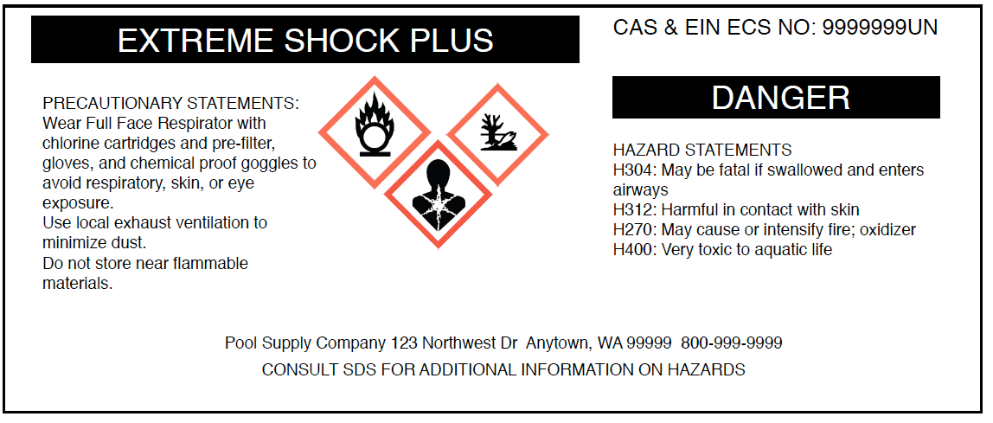
Getting Information
How do you get information about hazardous chemicals?
You can get information two ways:
From the product label
From the product Safety Data Sheet (SDS)

Slide 46
Getting Information
What is a Safety Data Sheet?
Safety Data Sheets (SDS) are information sheets on products that:
Tells what chemicals are in the product
What hazards are associated with the chemicals
How to protect yourself from the hazards
Search for Chemicals: http://chemicalsafety.com/sds-search/

Slide 47
What are the features of a SDS?
Chemical manufacturers and importers must obtain or develop a safety data sheet for each hazardous chemical they produce or import. Employers must have a safety data sheet in the workplace for each hazardous chemical which they use
The SDS must include information such as the properties of each chemical; the physical, health, and environmental health hazards; protective measures; and safety precautions for handling, storing, and transporting the chemical
Sections 1 through 8 contain general information about the chemical, identification, hazards, composition, safe handling practices, first aid measures, and emergency control measures (e.g., fire fighting). This information should be helpful to those that need to get the information quickly
Sections 9 through 11 and 16 contain other technical and scientific information, such as physical and chemical properties, stability and reactivity information, toxicological information, exposure control information, and other information including the date of preparation or last revision

Slide 48
Section 1: Identification of the substance or mixture and of the supplier
Section 2: Hazard identification
Section 3: Composition/information on ingredients Substance/Mixture
Section 4: First aid measures
Section 5: Firefighting measures
Section 6: Accidental release measures
Section 7: Handling and storage
Section 8: Exposure controls/personal protection
Section 9: Physical and chemical properties
Section 10: Stability and reactivity
Section 11: Toxicological
Section 12: Ecological information
Section 13: Disposal considerations
Section 14: Transportation information
Section 15: Regulatory information
Section 16: Other info including information on preparation & revision of SDS

Slide 49
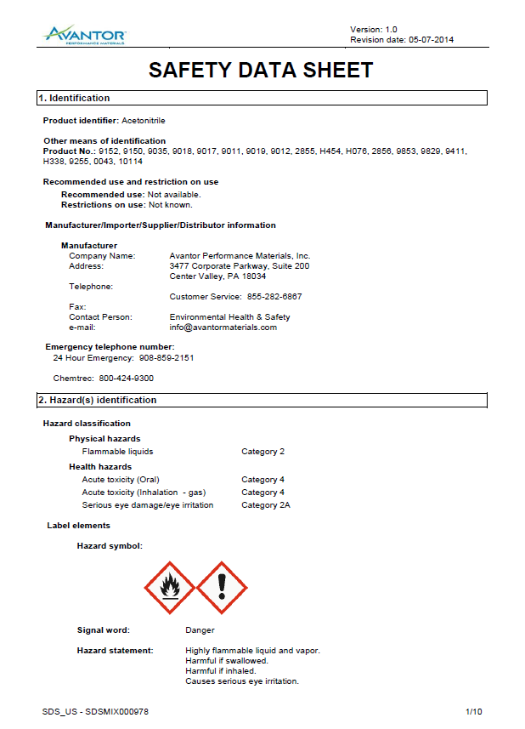
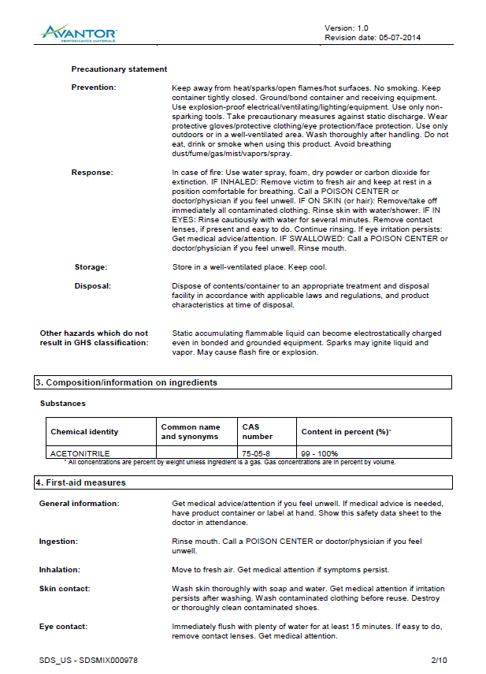
All SDSs will always contain the 16 sections in the same order

Slide 50

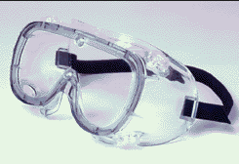

Protecting Yourself
You can protect yourself from hazardous chemicals by:
Knowing what is in the product you're working with
Using the smallest amount of a chemical to do the job
Wearing necessary personal protective equipment (PPE)

Slide 51
Hazardous Waste Disposal
Hazardous Waste Disposal
Properly Identified & Labeled Hazardous Waste is moved to Cavness Room 011A
Movement is Authorized by Department Chairs Only
EHSRM works closely with Vendor to Properly Package & Ship Hazardous Waste

Slide 52

Your Health is In Your Hands
Work smart and be safe in the lab.
You have control over your personal health.
Protect yourself,
your friends,
and your community!

