Slide 1
Essentials of
Biological Safety for Students
Environmental Health, Safety, & Risk Management

Slide 2
Course Objectives
Students who successfully complete this training will be able to:
Identify biohazardous materials
Apply risk assessment strategies in a laboratory setting
Identify routes of exposure to biohazards
Properly prepare for work in the lab
Properly handle and dispose of biohazardous waste

Slide 3
Biosafety Level 1 (BSL-1) Training
The primary principle of biological safety (biosafety) is containment
Primary containment protects people and the lab environment
Secondary containment protects the environment outside the lab
Please keep the following information in mind while working in the lab to ensure your own personal safety, the safety of your fellow lab mates, and the wellbeing of the general public and the environment.
Safety in the lab is our highest priority!

Slide 4
Developing a Culture of Safety
Safety must be important to laboratory administrators, workers, and students
Safety and health must be incorporated into laboratory processes
Nurture basic attitudes and habits of prudent behavior
Consider the health, physical, and environmental hazards to be used
Develop a culture of habitual risk assessment, planning, and considering of worst case scenarios

Slide 5
What Exactly is a Biohazard?
The Center for Disease Control and Prevention (CDC) defines Biohazardous Materials as: “infectious agents or hazardous biologic materials that present a risk or potential risk to the health of humans, animals, or the environment.”
The risk can be direct through infection or indirect through damage to the environment
The Biosafety Plan is designed as a quick reference guide or FAQ. It is available on the Risk Management website and in the lab.

Slide 6
What Are Biohazardous Materials?
Biohazardous materials include:
certain types of recombinant DNA, organisms and viruses infectious to humans, animals, or plants (e.g., parasites, viruses, bacteria, fungi, prions, and rickettsia),
and biologically active agents (e.g., toxins, allergens, and venoms) that can cause disease in other living organisms or cause significant impact to the environment or community.”
The Biosafety Plan is designed as a quick reference guide or FAQ. It is available on the Risk Management website and in the lab

Slide 7
Institutional Biosafety Committee (IBC) Approval
All research conducted by faculty, staff or students of Angelo State University involving any of the agents/materials listed below must be reviewed and approved by the Institutional Biosafety Committee (IBC) before beginning work:
Pathogens and potential pathogens of humans, animals, or plants;
Human or non-human primate blood, tissue, and cell lines;
Recombinant DNA (and RNA), including the creation or use of transgenic plants, animals and microbes;
Toxins of biological origin, including venoms;
Select agents and toxins including strains and amounts exempted from the select agent regulations; or
Any material requiring a CDC import license or a USDA permit.
See OP 34.29 and the Institutional Biosafety Committee website and Policies and Procedures for additional information.

Slide 8
Minimizing Exposures and Risks
Risk Assessment
What are the hazards?
What is the worst thing that could happen?
What can be done to prevent this from happening?
What can be done to protect from these hazards?
What should be done if something goes wrong?
Identify biological agents, amounts, circumstances of experiment
Evaluate hazards posed by biological agents and experimental conditions
Evaluate containment requirements
Select appropriate controls
  Engineering controls are best
  Administrative and work practice controls
  PPE where exposures remain
Implement and monitor for effectiveness
Information Sources
Safety Data Sheets (SDS)
Source Safety Summaries
Biosafety Plan
Institutional Biosafety Committee
ABSA Biosafety Links
Official Websites
CDC
NIH
OSHA
USDA

Slide 9
Professional Tip #1
Your lab supervisor will provide an overview and specific training before working with any biohazardous material.
Always follow protocols as they are there for your safety and the safety of others.
If you have questions, ask.

Slide 10
Noncompliance is Costly!
The National Institutes of Health Guidelines for Research Involving Recombinant or Synthetic Nucleic Acid Molecules, are normally referred to has the NIH Guidelines. While the word “guidelines” is usually thought of as good practices to follow, these guidelines are considered mandatory in research grants and noncompliance jeopardizes research funding.
Failure to comply with NIH Guidelines (or other applicable federal guidelines) and ASU safety plans can result in lost time and increased costs and significant delays, especially if the research project is linked to a defense or graduation
Sometimes, compliance failures are reportable to oversight agencies like the NIH or CDC; such mistakes can result in institutional penalties including loss of funding
If you have ANY questions about these issues, ask your laboratory faculty

Slide 11
Biosafety: What Is It? Why Do We Care?
Biosafety describes the basic and special practices necessary to safely handle and contain infectious microorganisms or hazardous biological materials
Biosafety also describes the safety equipment and facilities needed to protect personnel and the environment from exposure to biologically hazardous materials
In short, biosafety keeps you safe in the lab
*This link is for quick reference. You must take the course and successfully complete the exam on BlackBoard for credit.
This course focuses specifically upon biosafety. Review the Laboratory Safety Course* for additional laboratory safety guidance and requirements

Slide 12
Biosafety: Four Containment Levels
Biosafety Level 1
BSL-1 is the basic level of protection. BSL-1 labs work with well characterized agents not known to cause disease in healthy, immune competent adults. Work with biological agents in BSL-1 labs can be performed on the open bench top.
Biosafety Level 2
BSL-2 labs work with agents that pose a moderate hazard to personnel and the environment, either by accidental ingestion or percutaneous or mucous membrane exposure.
Specialized training is required to work in these labs, access to the lab is restricted, and procedures which may result in aerosol generation should be performed in a biosafety cabinet (BSC) or other physical containment equipment.

Slide 13
Biosafety: Four Containment Levels
Biosafety Level 3
This level of containment is appropriate for agents known to cause disease through the inhalation (aerosol) route of exposure, for agents associated with serious and potentially lethal infections, or indigenous or exotic agents.
Laboratory personnel must be supervised by competent scientists and require additional training. All procedures with infectious materials must be conducted within a BSC or other containment device when working at BSL-3. There are no BSL-3 labs at Angelo State University.
Biosafety Level 4
BSL-4 labs work with dangerous and exotic agents that pose a high risk of aerosol-transmitted infection and life-threatening disease, for which there are no vaccines or treatments. There are no BSL-4 labs at Angelo State University.

Slide 14
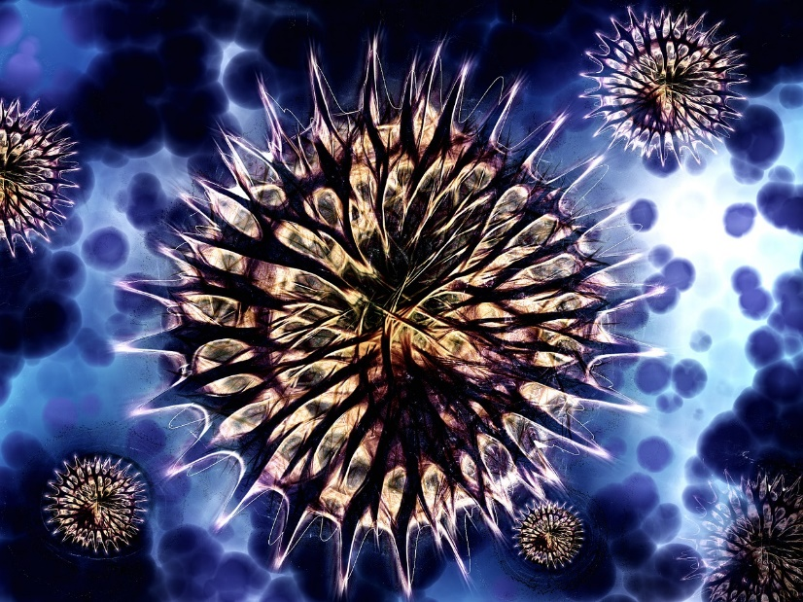
What is a Laboratory Acquired Infection (LAI)?
A laboratory acquired infection (or LAI) is an infection, disease, or illness that a laboratorian (aka: you) could get from a pathogen that you work with, or which is handled by others working in your lab.

Slide 15

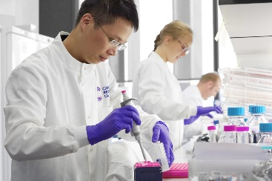
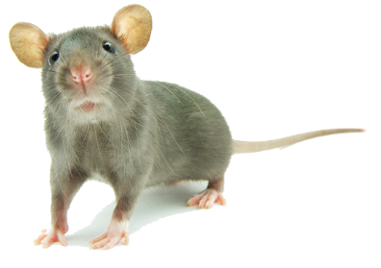
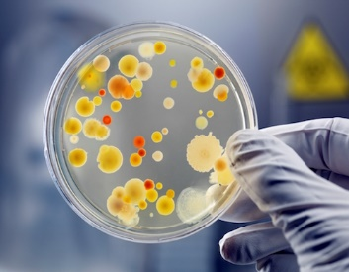
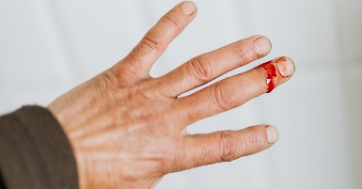
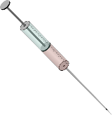
Chain of Infection
This Photo by Unknown Author is licensed under CC BY
Pathogen
Reservoir
Portal of Exit
Transmission
Portal of Entry
Susceptible Host
This Photo by Unknown Author is licensed under CC BY
This Photo by Unknown Author is licensed under CC BY-NC
Breaking the chain
at any point prevents infection!
This Photo by Unknown Author is licensed under CC BY-NC
This Photo by Unknown Author is licensed under CC BY-NC

Slide 16
Routes of Exposure - Skin
Parenteral Route:
Protect your skin
Your skin is your first line of defense. Protect all your skin, and cover all wounds, abrasions, new tattoos or skin damaged by acne, eczema, sunburn, or blisters while you’re in the lab.
Be extremely careful with sharp objects, including pipettes or broken glass. AVOID recapping needles or re-sheathing scalpels. Dispose of all sharps in an approved sharps container immediately after you finish using them.

Slide 17

Routes of Exposure - Ingestion
Do NOT eat food, drink beverages (even if it is in a lidded cup or bottle), chew gum, eat candy or cough drops, apply lip products, or take medicine in the lab
Do NOT pipet (siphon) lab materials or reagents by mouth
This Photo by Unknown Author is licensed under CC BY-SA-NC
If you put anything in your mouth while in the lab, you’re doing something wrong

Slide 18
Professional Tip #2
Have designated lab pens
Label them prominently
Leave them in the lab and don’t put one in your mouth!

Slide 19

Routes of Exposure – Mucous Membrane
Avoid rubbing your eyes, nose, or mouth, or otherwise touching your face with your hands, ESPECIALLY if you are wearing gloves
Work carefully and deliberately to avoid splashes, sprays and spills of hazardous materials, which can get into your eyes, nose, or mouth

Slide 20
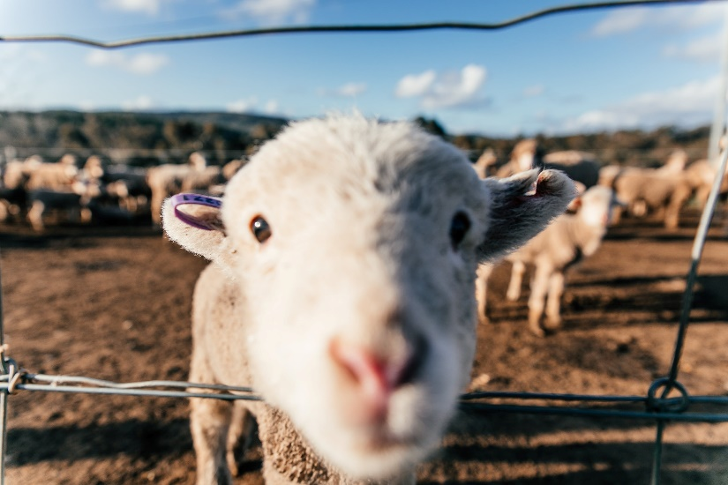
Routes of Exposure - Inhalation
No respiratory protection is needed when working at BSL-1.
However, you should learn and practice techniques that limit the generation of aerosols, splashes, and sprays of material into the air.
Do not sniff anything in the lab!

Slide 21
Fomites: Exposure Where You Least Expect It
A fomite is an inanimate object that can carry pathogens which can expose persons handling that object to infectious disease.
So, leave your cell phone, MP3 player, ear buds, backpack, purse, and other personal belongings at home or in a clean office or workspace.

Slide 22
Professional Tip #3
Leave your lab notebook either in the lab OR on your desk in your office. Don’t carry it back and forth.
Think about it. Your gloves touch contaminants of all kinds in the lab...
Your lab notebook becomes a vector.
Do you really want that on your desk?

Slide 23
Personal Protective Equipment (PPE)
PPE works as a barrier between you and the microorganism(s) you are handling.
PPE includes eye protection (safety glasses, face shields or splash goggles), a lab coat, and gloves.
Consider used PPE to be contaminated. It must be disinfected using heat (e.g. autoclaving) or chemicals before disposal or reuse.

Slide 24
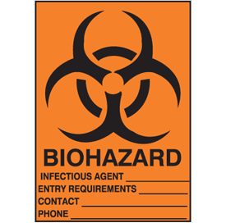

Read the Biohazard Sign before Entering Lab
BSL-1:
This identifies the space as a Biosafety Level 1 laboratory.
BSL-1
CAUTION!
The biohazard symbol lets you know you are entering an area containing living, biological agents which may cause harm to you or the environment.
ALWAYS Read the biohazard sign posted on the door before entering a lab
The biological agent(s) in use in this lab are listed here.
Emergency contact:
May be a Lab Supervisor or the Principal Investigator
Bacillus subtilis
PPE required when working in the lab is listed here.
Gloves worn, lab coats recommended
Dr. Elisa Blot
(999) 555-5555
http://www.seton.com/biohazard-sign-biohazard-m0884.html

Slide 25
What makes a laboratory safe?
It is equipped for safety
Labs should be equipped with working safety showers, eye wash stations, a sink with running water and adequate ventilation.
Work is performed safely
NO “horseplay” in the lab. Refrain from running in the lab and from shoving, startling, or jostling your lab mates or colleagues. Research and teaching labs are NOT the place for pranks!
It is easy to clean
All surfaces are smooth, non-absorbent, and easily cleanable – no rugs, curtains, or upholstered fabric furniture. If possible, don’t bring your backpacks, purses or satchels in a lab.

Slide 26
Biological and Biohazardous Waste Disposal
Biological Waste means discarded biological material from teaching and research laboratories and operations.
Biohazardous Waste means any solid or liquid biological waste that is hazardous because of its physical and/or biological nature. All waste that contains infectious material or which, because of its biological nature, may be harmful to humans, animals, plants or the environment is biohazardous waste. This includes:
Waste from infectious animals, bulk human blood, or blood products;
Infectious microbiological waste, including contaminated disposable culture dishes and disposable devices used to transfer, inoculate, and mix cultures;
Pathological waste;
Sharps; and
Hazardous products of recombinant DNA biotechnology and genetic manipulation

Slide 27
Biological and Biohazardous Waste Disposal
Segregate and properly package and label sharps, waste to be incinerated, & biohazardous waste.
Biohazardous waste should be treated and disposed of promptly.
Biohazardous material must be rendered harmless by appropriate treatment.
Each container of untreated biohazardous waste must be clearly labeled.
It is good practice to autoclave or disinfect all microbial products.
After treatment to eliminate the biohazard, dispose of material that remains hazardous through EHSRM.
Waste treatment records must be maintained.
Biological waste that is not infectious or hazardous may be discarded normally.
The Biosafety Plan contains detailed information on biohazardous waste disposal and transportation.

Slide 28
Disinfecting Equipment, Cultures, and Surfaces
In order to prevent potential exposure of personnel or release of biohazards into the environment, disinfect and dispose of lab materials properly.
Decontaminate work surfaces after you’ve completed your work and especially after any splash or spill of biohazardous materials.
Decontaminate all microbial cultures, prior to disposal, by either autoclaving or using agent appropriate disinfectants.
Decontaminate used and disposable lab supplies, prior to disposal, by autoclaving.
Regularly clean and decontaminate non-disposable laboratory equipment using disinfectant, especially prior to removal from the lab.
The Biosafety Plan contains detailed information on disinfection and sterilization.

Slide 29
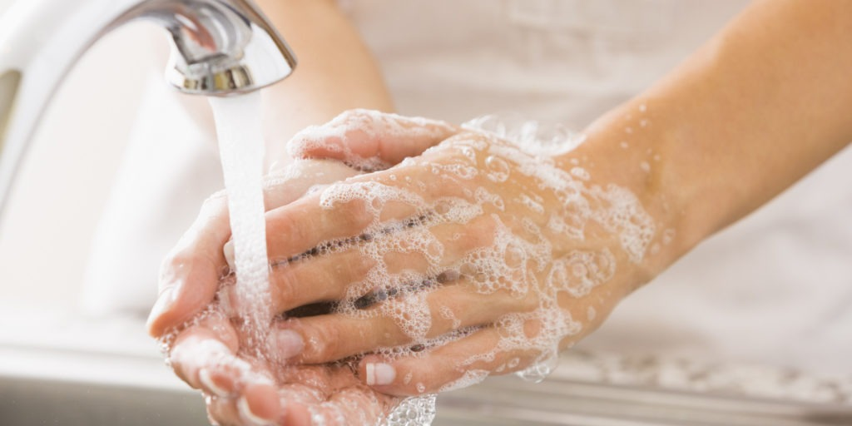
Hand Washing
Washing your hands is the #1 way to prevent the spread of disease.
It’s simple.
Use plenty of soap, add water and lather well.
Take your time...at least 30 seconds to ensure your hands are clean.
30 Seconds = Twice Through . . .
Happy Birthday song
Twinkle Twinkle Little Star
Your A B C’s
This Photo by Unknown Author is licensed under CC BY-NC-ND

Slide 30
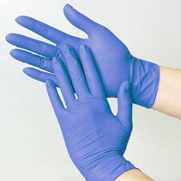
Fact Check
“I wore gloves, so I don’t need to wash my hands because they aren’t dirty.”
FALSE – Here’s why:
Gloves are not a substitute for good hand hygiene.
Your hands sweat in gloves.
Bacteria thrive in a warm, moist environment . . . just like the one conveniently provided by your gloved hand.
Gloves may have microscopic holes large enough for microbes to enter!
This Photo by Unknown Author is licensed under CC BY

Slide 31
When in Doubt, Ask!
If you are not sure how to do something correctly, always ask your supervisor* first.
Mistakes and accidents can happen, but it’s always better to be safe than sorry – so ask first!
There’s no such thing as a stupid question!
*May be your professor, Principal Investigator in a research setting, teaching assistant, or lab supervisor

Slide 32
Professional Tip #4
Don’t be afraid to report any incident in the lab
No spill or accident is too small to report to your supervisor, even if it only involved something non-infectious or non-recombinant

Slide 33
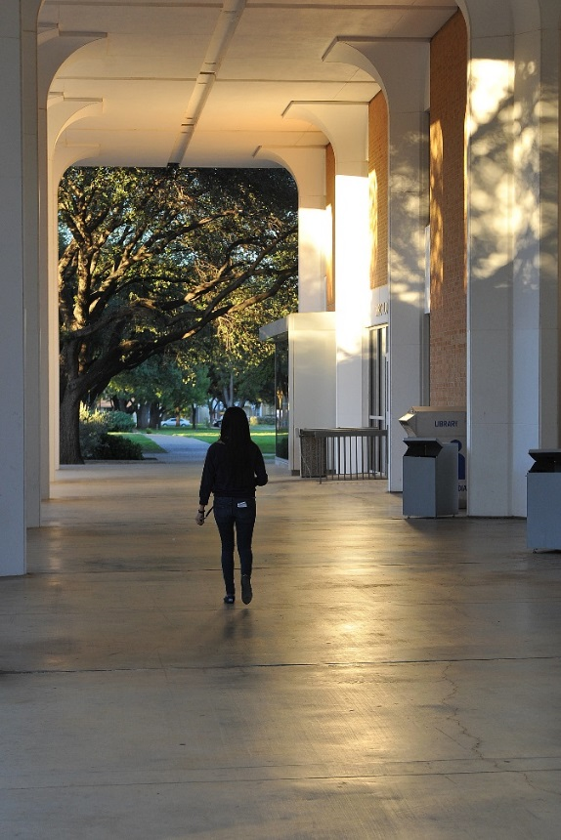

Your Health is In Your Hands
Work smart and be safe in the lab
You have control over your personal health
Protect yourself,
your friends,
and your community!

