Slide 1
The 4-1-1 on Contract Administration

Slide 2
What is Contract Administration?
The Goal of Contract Administration is to ensure contracts are satisfactorily performed by both the contractor and ASU, so that contract responsibilities are clearly defined and can be properly discharged at the completion of the contract.
The specific nature and extent of Contract Administration varies from contract to contract depending on several factors, such as scope of work and type of contract. Standard provisions for contracts will vary.

Slide 3
What are the Responsibilities of the Contract Administration Office
Reviews the contracts for institutional risks.
Verifies that contracts are in compliance with Texas state laws.
Negotiates contract terms and conditions with vendors (contractors).
Submits the contracts for legal review, as deemed necessary. The Office of General Counsel requests thirty (30) days to review pending contracts.
Notifies the departments on the status of the contracts as they progress through the review process.
Ensures that contracts are reviewed and signed by the appropriate personnel.
If original signatures on contracts are required, Contract Administration will charge postage to departments.
Disseminates the contracts to the departments and the contractors, and retains one copy for its files.

Slide 4
Responsibilities of the Contract Administration
Office (cont.)
Verifies that bonds and insurance are provided, as required by a contract or university policy.
Assists departments with the Vendor Contract Performance Form in accordance with the terms and conditions of a contract.
Notifies the departments when contracts are expiring and require procurement or renewal. Closes out agreements upon completion.
Serves as the repository for all university contracts, except for contracts routed through the Office of Facilities Planning and Construction and external sponsored programs.
Conducts audits on major university contracts. Reports non-compliance of contracting policies to the Office of Internal Auditing.
Reports to the LBB all major contracts, amendments, modifications, renewals, extensions, requests for proposals, invitations to bid or comparable solicitations related to major contracts.

Slide 5

What is a Contract?
A contract is an agreement between two or more (competent) parties or persons that creates an obligation to do or not do a particular thing.
AGREEMENT
Subject matter sufficiently defined
  Meeting of the Minds
TWO OR MORE PARTIES OR PERSONS
Separate Legal Entities
Legal Capacity (competency)
OBLIGATION
A legal requirement subject to enforcement in a court of law
TO DO OR NOT DO A PARTICULAR THING
Mutual understanding as to the requirements

Slide 6
What are the Essential Elements of a Contract?
An Offer
  A specific proposal to enter into an agreement as an enforceable contract.
An Acceptance
  An offeree’s agreement, verbally or in writing, to the terms of a contract.
Competent Parties
  A competent party is “sufficiently mentally able to understand and execute the document.”
Mutual Consideration
  A benefit which two parties bargain for and is the primary reason either party enters into a contract.
Legality of Purpose
  Courts will not enforce contracts that are for an illegal purpose.
Certainty of Subject Matter
  The reason you are entering into the contract must be stated and the terms to which each party is subject to must be clearly defined and specific. If material terms are omitted, there is no contract to enforce.

Slide 7
Contracts include, but are not limited to:
  Agreements
  Cooperative Agreements
  Memoranda of Understanding
  Interagency Contracts
  Clinical Agreements
  Purchase Orders
  Loans
  Easements
  Insurance Policies
  Licenses
  Leases
  Permits

Slide 8
Written Contracts should be executed whenever ASU enters into a binding agreement with another party that involves any amount, and for any purpose between ASU and other parties.
Other Parties include but are not limited to:
Federal Agencies
State Agencies
Local Agencies
Non Profit Organizations
Private Businesses
Partnerships
Individuals

Slide 9

What standard provisions should contracts include?
Introduction
  Identifies the parties and the binding nature of the contract
    ASU should be Identified as an “Institution of Higher Education of the State of Texas and a member of the Texas Tech University System.”
    Contractor should be indentified by it’s full legal name, type of entity (if applicable) and the state in which it is located.
Scope of Work
  The true subject matter of the contract
    Each duty and obligation of each party should be clearly described, including any necessary details regarding how the duties and obligations will be performed.
Term of the Contract
  A definite period of time that the contract will remain in effect
    Needs to be a set day, date or condition for the contract to start and a day, date or condition for the contract to end.
    If the effective date of the contract is different from the date of execution, then the execution date should be clearly stated.

Slide 10


What standard provisions should contracts include?
Payment
  Describes the method of payment and contract payment type
    Should Include the process of payment to the contractor, the format of invoices, the timing of invoices and payment schedule.
Force Majeure
  Excuses a party from liability if some unforeseen event beyond the control of the party prevents it from performing its obligations under the contract
    Usually includes acts of god, riots, strikes, natural disasters, terrorism, war, epidemics, etc.
Independent Contractor Status
  In the case of an independent contractor, the state agrees that the contractor is not an employee of the state, and the state is not liable for negligence as a result of the work the contractor performed, or for any subcontractor-related disputes.
Assignability
  In general, neither party shall be able to assign its duties and obligations without the permission of the other party.

Slide 11


What standard provisions should contracts include?
Venue
  Governs where a case will be tried should a lawsuit arise
    All contracts should be governed by Texas law, otherwise you may be forced to hire outside counsel to represent you in another state.
    The venue should be Tom Green County.
Severability
  If any term or provision of an agreement is found to be invalid, the invalidity of that section should not effect the validity of any other section of the agreement, provided that the invalid provision is not material to the overall purpose of the agreement.
Default
  If the contractor does not abide by the terms of the contract, the inclusion of an abandonment or default clause provides a way for the state to cancel the contract at the time of non-performance.
    Events of Default should be clearly stated.
    The name, address, e-mail, telephone number and fax number of each party to be notified, should a default or breach occur, should be included.

Slide 12


What standard provisions should contracts include?
Termination
  Provides a remedy in the case of default or breach of a contract’s terms.
Dispute Resolution
  The dispute resolution process provided for in the Texas Government Code, Chapter 2260, shall be used to resolve any unresolved claim for breach of contract arising under any agreement.
    State agencies are required by Chapter 2260 to add the provision to all contracts for goods or services.
    Texas Government Code, Chapter 2260
Buy Texas
  Simply holds the contractor responsible for buying Texas-made products, when available, if the price and quality are comparable to the equivalent non-Texas-made product at a given time.
Vendor Hold Status
  Agencies and institutions of higher education are required to verify a vendor’s hold status for payments with the State of Texas. Vendors on hold with the state will not receive payment for services until the hold status has been cleared.

Slide 13

What provisions should not be included in contracts?
Attorney Fees & Line of Credit Terms
  We cannot agree to pay any attorneys fees.
    Tex. Govt Code §2260.003
  The Texas Constitution provides that the State cannot give, lend or pledge the credit of the State to any person, association or corporation, or make any grant of public monies to any person, association or corporation without express authority.
    Texas Constitution, Article 3, Sections 50-52
General Liability Insurance
  We cannot provide general liability insurance.
    It is the stated policy of the State of Texas not to acquire commercial general liability insurance for torts committed by employees of the state who are acting within the scope of their employment. Rather, third parties must look to the Texas Tort Claims Act for relief with respect to property damage, personal injury and death proximately caused by the wrongful act or omission or negligence of an employee acting within his scope of employment as more fully set out above.
      Texas Tort Claims Act, Texas Civil Practice and Remedies Code, Chapter 101
Confidential Information
  Our ability to keep information confidential is limited by the Texas Public Information Act.

Slide 14
What provisions should not be included in contracts?
Indemnification of any party
  ASU cannot agree to reimburse a person for a loss already incurred.
    The Texas Constitution provides that the State cannot give, lend or pledge the credit of the State to any person, association or corporation, or make any grant of public monies to any person, association or corporation without express authority.
      Texas Constitution, Article 3, Sections 50-52
Arbitration
  ASU cannot agree to a formal system to deal with grievances and administer corrective justice, binding or not.
Workers Compensation
  Employees of Angelo State University are provided workers compensation coverage under Texas Labor Code, Chapter 501 .
    Texas Labor Code, 501
Warranties
  We cannot allow any contractor to waive any warranty explicitly given by a manufacturer or seller (express warranty) implied by law that the item is fit for a particular purpose (implied warranty of fitness for a particular purpose) or implied by law that goods are reasonably fit for the general purpose for which they are sold (implied warranty of merchantability).

Slide 15
What do I do if my contract contains provisions that shouldn’t be included in contracts?
Send the contract through the contract routing process.
  The Contract Administration Office will contact the vendor to negotiate contract terms.
  Please understand that the contract will take longer to process.

Slide 16
Stages of a Contract
The following elements of contract management must be considered:

Slide 17
1. Contract Initiation
Departments requesting to enter into a contract should first determine if procurement is required. If so, please refer to Angelo State University Operating Policies & Procedures.
  OP 30.06 Professional Services
  OP 54.04 Purchase of Goods and Services
  OP 30.05 Use of Private Consultants

Slide 18
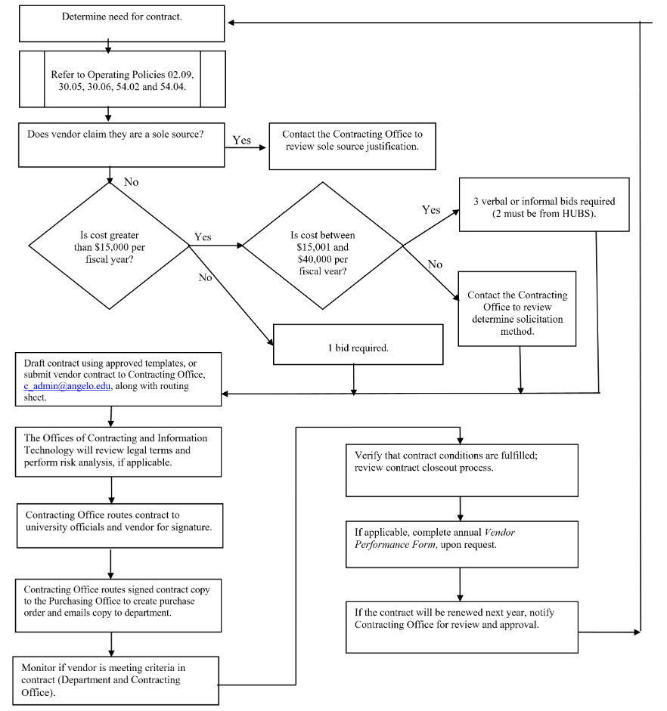
Contract Process Flowchart

Slide 19
We Want YOU to Remember….
Bid Requirements
  Procurement between $0-$15,000
    One bid is required
  Procurement between $15,000.01-$40,000
    Three verbal or informal bids required
    Two should be certified HUBS
  Procurement Over $40,000.01
    Formal bids/proposals required
    Contact the Purchasing Department
BUY HUB!!
  Account managers should purchase from HUBs to the fullest extent possible.
  OP 54.02 Historically Underutilized Businesses
  For a Texas HUB Vendor List please see: Angelo State University Vendor Lists

Slide 20
3. Contract Formation
2. Contract Formation
Contract Administration Approved Templates:
Request for Proposal template, if a request for proposal (RFP) is required
Student Clinical Experience Program Agreement
Field Placement Interagency Affiliation Agreement
Student Internship Experience Program Agreement
Professional/Consulting Services Agreement
University Agreement
General Contract Template
Departments that receive vendor contracts instead of using an approved template must submit contracts to Contract Administration Office for review.

Slide 21

If possible, please
initiate contract requests at least 6 weeks prior to the start date of the contract to allow ample time for review and approval.

Slide 22
3. Appoint Contract Monitor
Each department should appoint a Contract Monitor (CM)who will:
  Assist in developing contract specifications
  Monitor contractor’s progress and performance
  Manage any university property used in contract performance
  Authorize payments consistent with contract documents
  Exercise remedies, in conjunction with the Contract Administration Office, when a contractor’s performance is deficient.
  Resolve disputes in a timely manner
  Document significant events
  Maintain appropriate records

Slide 23
Who should I assign to be the Contract Monitor?
Goods and Services
  The department head should assign a CM to monitor contracts.
    Purchaser for the respective department
    Should have account authority privileges
Revenue Contracts
  CM for revenue contracts is the department head.
    If the contract is new, the generating department will need to complete a New Account Request Form and send it to the Controller’s Office.
    All payments received should be forwarded to the Vice President for Finance and Administration.

Slide 24

4. Submit Proposed Contract
Departments must direct vendors to PaymentWorks to be established as a vendor, if they have not done business with ASU in the past. Then, submit the contract template to Contract Administration. Contract Administration can assist departments with sending an Invite to a vendor for PaymentWorks.
Departments requesting approval on vendor contracts (non-ASU templates) must submit a Contract Routing Sheet and ONE copy of the contract.
  If possible, departments should e-mail the proposed contracts to the Contract Administration Office at C_admin@angelo.edu
Don’t Forget to complete a Contract Routing Sheet!!

Slide 25
5. Attach Contract Dispute Resolution
Per the Attorney General’s Office, the Contract Dispute Resolution MUST be included in all state contracts for the purchase of goods or services.
  The Contract Dispute Resolution notifies the contractor of the remedies available to them under Chapter 2260 of the Texas Government Code should a breach occur that cannot be resolved in the ordinary course of business.
  The State of Texas is immune from liability and from suit with respect to most causes of action against it under the doctrine of sovereign immunity. This means that the State of Texas cannot be sued in its own courts without its legislature’s consent.
Whether the contractor chooses to sign or not, Chapter 2260 still applies to the contract at hand.

Slide 26

4. Complete Routing Sheet
6. Contract Review and Routing Process
  For Clinical and Affiliation Agreements, use the Clinical and Affiliation Contract E-Routing Sheet.
  For all other types of contracts, use the Contract E-Routing Sheet.
Departments are responsible for completing the Contract Routing Sheet and forwarding it, along with the contract, to c_admin@angelo.edu. Contract Administration Office will not review contracts until a Contract Routing Sheet is received.
Refer to OP 30.02 for routing and review procedures.

Slide 27

7. Fiscal & Legal Review
7. Fiscal and Legal Review
Upon receiving contracts, the Contract Administration Office will:
Review proposed contract for fiscal and legal implications.
If necessary, request that the contractor add or remove language in order to limit the amount of institutional risk incurred by the university.
Determine if additional legal and fiscal review is needed based on the amount and type of contract.
  If so, proposed contract will be routed to our legal counsel at Texas Tech University.

Slide 28
Hello, this is the Contract Administration Office. Your contract has been APPROVED!
The Contract Administration Office will notify departments on the status of the contracts as it progresses through the review process.

Slide 29
8. Execution of Contract
Do NOT sign a contract until it has been approved by the Contract Administration Office.
Upon approval, the Contract Administration Office will route contract to ASU officials listed in OP 30.02 and to contractors for signature approval.
If applicable, the Contract Administration Office will email the contract to the financial manager to request approval and then forward to the Purchasing Office to create a purchase order. The Contract Administration Office will route a signed contract copy to the department along with a copy of the purchase order.
  The Contract Administration Office will act as the repository for all the university’s contracts, and will keep all original contracts.

Slide 30
What kind of authority do I have ?
Actual authority is the authority that an individual
was intended to have. Actual authority can be
implied or expressed.
  Implied authority is not communicated or written down , but is intended by virtue of a person’s position.
    For example, the CEO may be implicitly authorized to enter into contracts.
  Expressed authority is communicated specifically and almost always in writing.
    For example, a particular employee may have the authority to approve contract modifications up to a certain monetary value.
  Apparent authority is the authority that individuals are not intended to have. Do NOT sign a contract unless you have authority to do so, and it is approved by the Contract Administration Office.

Slide 31
Did You Know…..
An individual executing a contract on behalf of a state agency without the authority to do so may be personally liable for damages flowing from repudiation of the contract.
Thomas, Richardson, Runden & Company, Inc. v. State of Texas
  Thomas, an employee of the Texas Railroad Commission, was found personally liable for a contract he signed that he was not authorized to sign. The Railroad Commission repudiated the contract and the vendor sued the State of Texas and the Railroad Commission. The court found that the employee was liable due to the employee’s “implied warranty” of authority to execute the contract. The court ordered the employee to pay for the value of the services performed by the vendor and court costs.

Slide 32
9. Monitor Contract
9.Monitor Contracts
CM should monitor contracts to ensure:
  Contractor’s performance is in compliance with the terms, conditions and requirements of the contract/agreement.
  ASU compliance with the terms, conditions and requirements of the contract/agreement.
  Purchase orders issued under the contract/agreement are in compliance with the term, conditions and requirements of the contract/agreement, if applicable.
  Payments are in compliance with the terms and conditions of the contract/agreement.
If non-compliance of contract terms occurs, the CM should contact the Contract Administration Office for assistance.
Prior to closeout, CM should complete Vendor/Contractor Performance Form. See OP 30.03 for exceptions.

Slide 33
10. Contract Closeout
10. Contract Closeout
Contract closeout begins when the contract is complete with all services performed and products delivered.
Closeout is completed when all administrative actions have been completed, all disputes settled and final payments made.
Closeout file contents:
  Encumbrance documentation or purchase order
  Addenda
  Fully executed copy of contract (both parties’ signatures)
  Submitted proposals
  RFP
  Best and final offers
  Proposal tabulation
  Appropriate justification
  Award recommendation
  HUB participation plans
  Correspondence
  Vendor/Contract Performance Form
  Review Reports

Slide 34
What is the Vendor/Contractor Performance Form?
The Vendor/Contractor Performance Form provides the ASU procurement community with a comprehensive tool for evaluating vendor performance to reduce the risk in the contract award process.
The purpose of the Vendor/Contractor Performance Form is to:
  Identify vendors that have exceptional performance.
  Aid purchasers in making a best value determination based on vendor past performance.
  Protect ASU from vendors with unethical business practices.

Slide 35
Do I complete a VPF for every contract
Vendor Performance Contracts should be completed for all contracts in excess of $10,000, except for:
  Publishing agreements for the Print Shop
  Conference room agreements
  Sponsorship agreements for Athletics
  Employment contracts
  Membership fees and dues
  Purchases from federal agencies
  Purchases from the Texas Department of Criminal Justice
  Purchases from Texas Industries for the Blind and Handicapped
  Subscriptions
  Lecturers and guest speakers

Slide 36
11. Contract Renewal
(if applicable)
Contract Renewal
(if applicable)
Contract Administration Office will notify departments of expiring contracts:
  Contractor must provide quote for renewal of services.
  Financial Managers must authorize renewal of contract.
  Contract Administration Office will route to university officials for signature and to the contractor.
All renewal contracts may be subject to fiscal and legal review.

Slide 37
Suggestions to Improve Contract Expedition
Ensure that funding amount is available and account numbers are listed correctly on routing sheet.
Complete contractor information on routing sheet
  Make sure contact information is correct for contractor.
  Make sure to list name of the Contractor Representative.
Use an approved ASU template whenever possible.
  Please contact the Contract Administration Office if you would like to create a contract template to address the needs of your department.
Make sure all attachments referred to in contract are submitted for
review.
Attach any previous correspondence with contractor.

Slide 38
Who to call for contract questions:
Please call us if you have questions regarding contracts
  Lanell Nichols, Executive Director of Materials Management – ext. 6850
  Whitni Cary, Materials and Contracts Coordinator – ext. 2748
We’re here to help!

