Slide 1
Angelo State University
Salary Encumbrances in Banner Finance

Slide 2
Salary Encumbrances
Beginning FY 14 salaries will be encumbered for full-time faculty and staff. Salaries for part-time faculty as well as student workers and work study students will not be encumbered.
Encumbrances are created for salaried employees at the beginning of the fiscal year or for new hires after the Electronic Personnel Action form (ePAF) is approved.
Annual salaries are encumbered and reduced throughout the year as the payroll expenditures are posted. This process allows financial account managers to track salary commitments against their departmental budgets in Banner.
Payroll encumbrances do not include benefits.

Slide 3
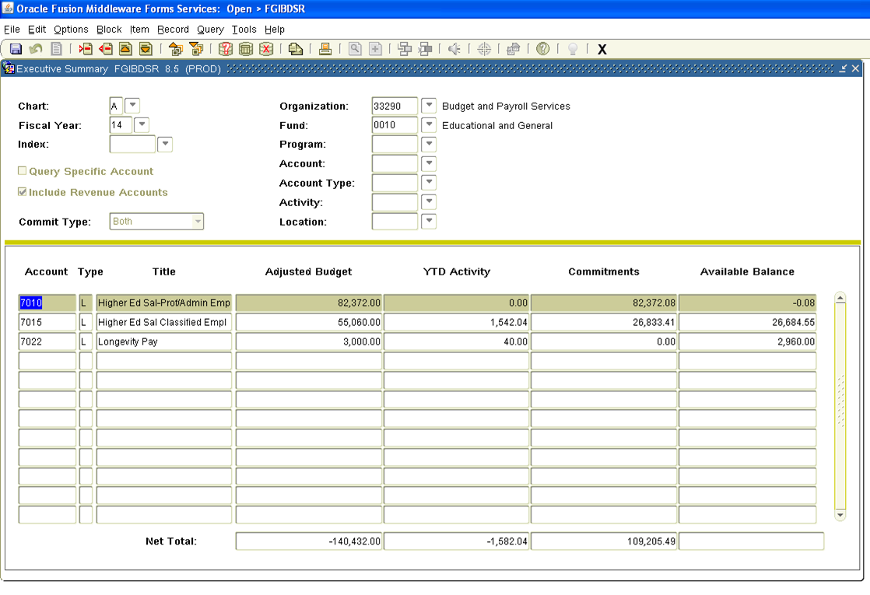
FGIBDSR
On Banner Finance form FGIBDSR, the salary commitments appear in the Commitments column.

Slide 4
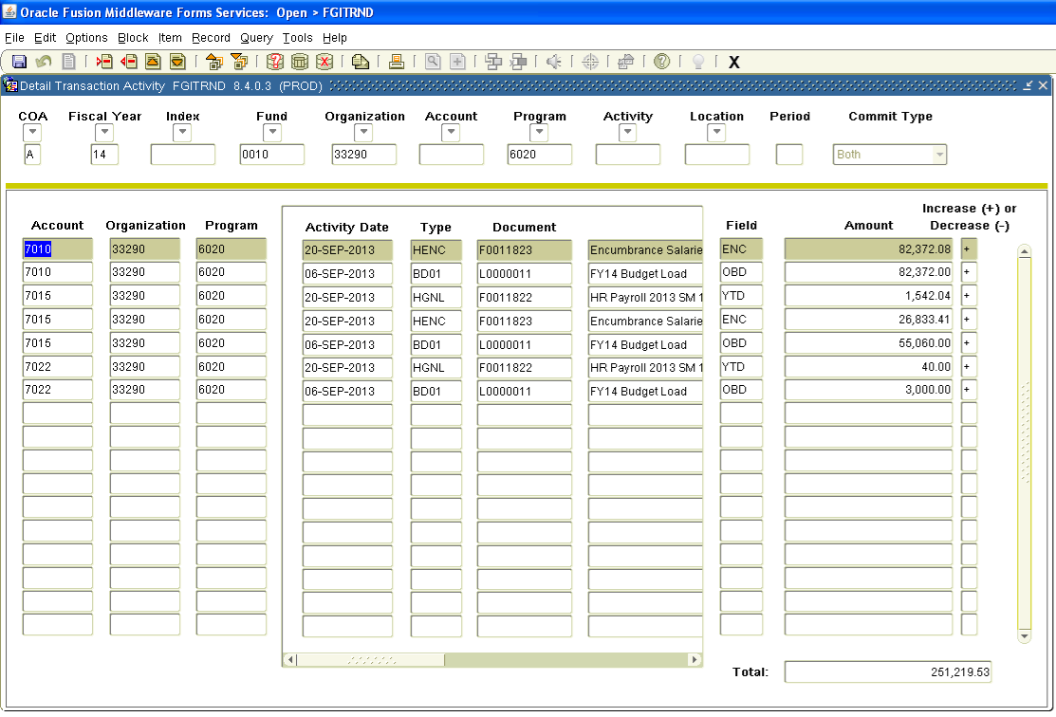
FGITRND
Banner Finance form FGITRND shows the detail for the salary encumbrance entries.

Slide 5
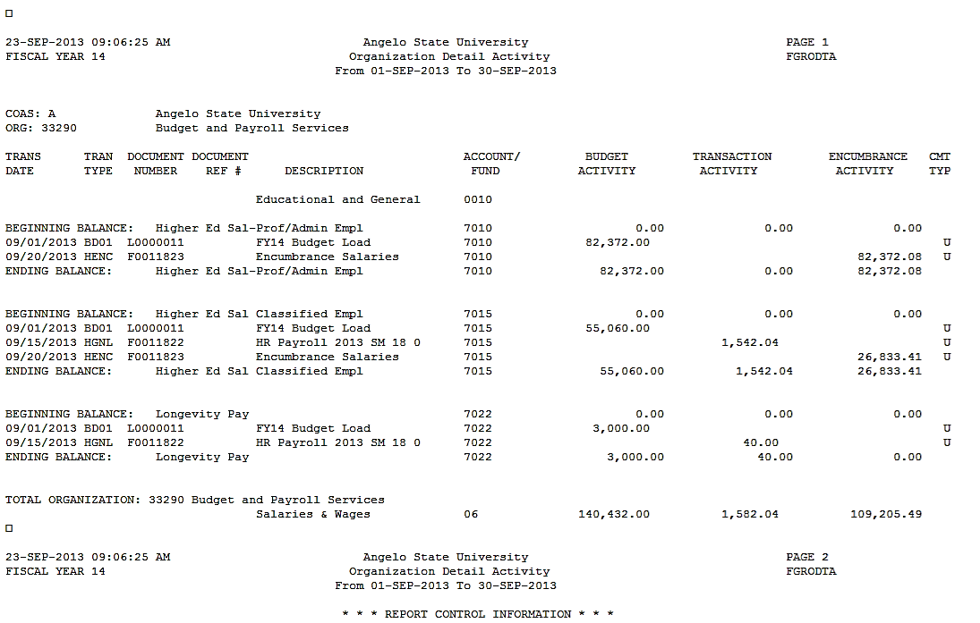
FGRODTA
Banner Finance form FGRODTA shows the organization’s detail account activity and is used by many departments to reconcile their accounts.

